Slide 1
Secure Data Integration & Managed File Transfer
API-Driven B2B Integration
Leverage APIs & Microservices to power digital transformation across your organization
Mike Albritton, GM
RSSBus
www.rssbus.com
Notes:
Who am I? Been in the component industry for many years, specifically the EDI component industry

Slide 2
Agenda
At a glance
Background – Customer Story
What are APIs?
Benefits of a Microservice Architecture
Checklist for an API Platform
Case Studies
Notes:
Start off with a brief introduction of my background, then we will get into What are APIs?
Next we will explore the benefits of APIs
How you can build an API strategy for your business
And close with some real world examples

Slide 3
Customer Story
Large logistics company that provides logistics across many different industries
Situation: Invested in a large footprint monolithic system for many years
Complication: Custom built and maintained system with a large team supporting the system
Need: A scalable platform that is capable of replacing existing solution and able to extend to new content sources, technologies and enhanced business processes
Solution: Develop an API based strategy and begin to migrate solution components using a risk-based approach; start with least risky (MFT) and migrate to more complex EDI translation and integration and lastly, develop a tighter integration with the ERP platform.
Notes:
20 year old open source projects, no longer maintained
Company has built a large development team to maintain these technologies
Large monolith

Slide 4
What are APIs & Microservices
Why the hype?
Application Programming Interface
Legacy from Component-based Engineering -
A reuse-based approach to defining, implementing and composing loosely coupled independent components into systems. Evolution of SOA
Notes:
Let’s get into APIs. API is not a type of beer.
The legacy of APIs and Microservices align with the history of service oriented architectures and component based development. In essence, component based architectures seek to modularize systems and processed and use them like building blocks

Slide 5
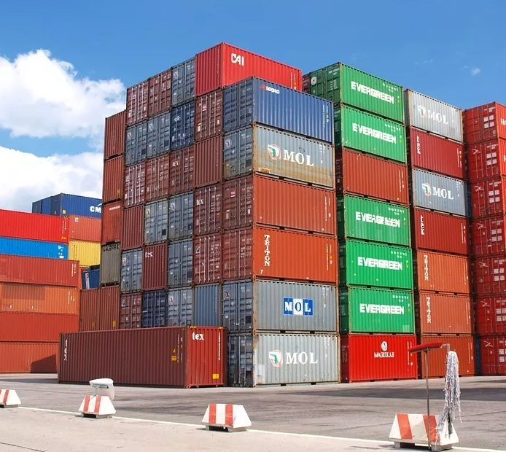
Monolith vs Microservices
Notes:
Point out a couple of things here-
The microservices are compartmentalized
Components are interchangeable- can be smaller, can be larger, depending on the size of the project. Monoliths may be limited in size due to the complexity of maintaining them.
Monolith is floating on water vs. being on solid ground
What does your current EDI solution look like?

Slide 6
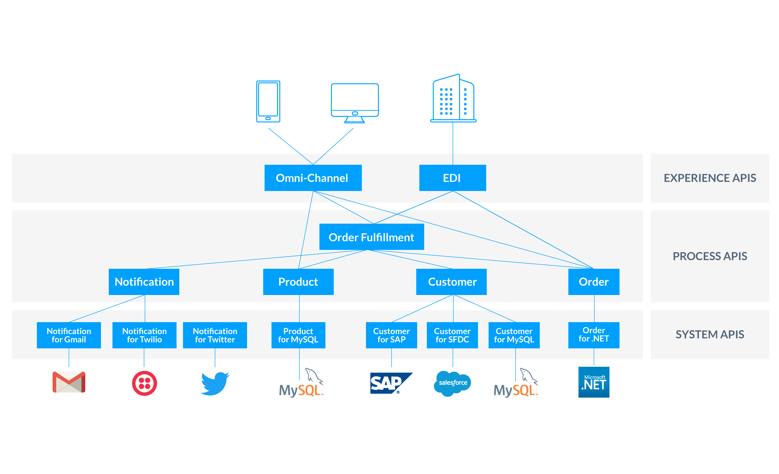
EDI Process (Microservices Architecture)
Enable self-service, low code, & no code integration
API-Led Connectivity
Notes:
Now we are going to look at what a Microservices architecture looks like.
We are going to reference this slide throughout the presentation.
Talk about what an order fulfillment process looks like
Omni-channel web checkout
EDI process API
How the pieces are reusable
What would this look like if it were a monolithic architecture as opposed to a microservices one?

Slide 7
Monolithic Architectures
Pros & Cons
Pros
Cons
Convenience
Consistency
Complexity
Limited Reuse
Not Scalable
Lack of Agility
Technology Lock-in
Testability
Notes:
- As with anything, you cannot blindly say monolith is always better or worse than microservices. There are times when it may be better, and others when it is not.
https://gigaom.com/2015/11/06/why-monolithic-apps-are-often-better-than-microservices/
- Performance? Security? - talk about them and how to mitigate those
- Also note that monolithic applications come with issues like employee lock in – if you have employees trained on a system they are stickier

Slide 8
Microservices Architectures
Pros & Cons
Pros
Cons
Convenience
Scalability
Complexity
More Moving Parts
Resiliency
Reliability
Performance
Monitoring
Flexibility
Testability
Notes:
Complexity is really not something that anyone can get away from. In the microservices architecture it’s just distributed
Here complexity speaks to difficulty testing the system as a whole – however individual pieces can be tested, and as a result it is easier to build things like unit tests against services etc.
Flexibility talks about technology flexibility – individual functions are ‘componentized’
Continuously updating – and can change at the speed of business.

Slide 9
EDI Process (Microservices Architecture)
Enable self-service, low code, & no code integration
API-Led Connectivity
Notes:
Going back to the microservices slide, we want to now look at what APIs that are exposed to business partners can look like.

Slide 10
API is the EDI of the 21st Century
A better way to encapsulate and transmit information
API technology syncs data B2B in real-time
Reduces cost and time when compared to developing EDI Processes
Improves customer experience with streamlined carrier data integrations
Users receive advanced features easier, faster – and at less of an expense to you
Notes:
Current day APIs (microservices) are designed to allow internal processes or systems to talk to each other- this is much like EDI, just that EDI is external and formalized
The question then, is why can’t APIs be used to connect businesses? It can.
- Last point- it’s agile, give an example of making a change, how much easier it is

Slide 11
Great, Will it Work?
Using APIs to integrate B2B processes instead of traditional EDI
Benefits
Trigger based data exchange
Hurdles
Companies unwilling to change
Less batch processing
Understandable by mortals
Easy to setup and configure
Not as standard
Security is a concern
Notes:
- Can’t change the world (not going to tell Amazon you’re using APIs and not EDI)
- You can use an API in place of a web form to make things more integrated with less manual intervention/mistakes
- Typically can be produced/consumed without writing code

Slide 12
Checklist for API Technology

Slide 13
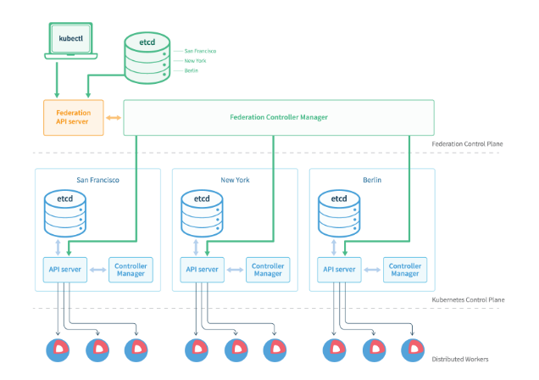
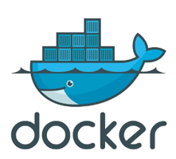
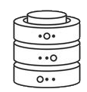
Distributing Load
Support distributed delivery and high-availability
Region 1
Region 2
Region 3
Support for modern container technologies and cloud deployment.
Reduce deployment time and compute footprint.
Improve response times and scale on-demand.
Cloud deployment for scale.
Federation Control Plane
Region 1
Region 2
Region 3
Kubernetes Control Plane
Distributed Workers
On-premise or Cloud Storage
Notes:
- APIs are only helpful if they are separate processes
- Container technologies make monitoring, deployment, etc. much easier

Slide 14
EDI Process (Microservices Architecture)
Enable self-service, low code, & no code integration
API-Led Connectivity
Notes:
Going back to the API architecture slide, now we want to look at what an API solution must have if you intend to expose user APIs

Slide 15
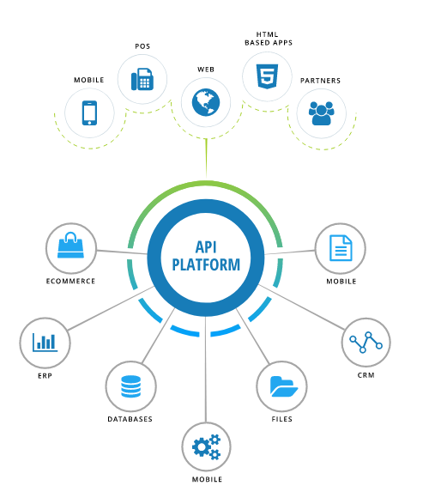
Experience Layer
APIs designed to create a great user experience
Documentation
Standards based
Granular user control
Monitoring
Scalable
Versioning
No dependency on underlying processes or systems
Notes:
Scalable- vertical/horizontal, also supports caching

Slide 16
API’s @ the Edge
Critical support for every B2B communications interface
All Major EDI Protocols: AS1 -> AS4, OFTP, FTPS, SFTP, SMTP, Email
EDI Mapping & Translation: Edge support for routing transactions
API Interfaces: REST, OData, JSON, Swagger
Logging / Monitoring
Notes:
Critical to support all standards for file transfer, EDI translation, etc.
Need standardized API interfaces
Robust logging and monitoring capabilities

Slide 17
EDI Process (Microservices Architecture)
Enable self-service, low code, & no code integration
API-Led Connectivity
Notes:
Next, we’re going to look at what the process APIs look like and what you need in this layer

Slide 18
Process Layer
RESTful APIs Layer over Data Abstraction
Order Processing
Create Order
Order Fulfillment
Create ASN
Generate Invoice
APIs that process and move data between systems
Functions or Actions
Do not need a dependency on the underlying system that owns the data
No knowledge of where the data is being pushed
Typically custom-designed for process requirement
Notes:
Logical components
Decisions
Caching

Slide 19
EDI Process (Microservices Architecture)
Enable self-service, low code, & no code integration
API-Led Connectivity
Notes:
Finally, look at what the system layer APIs look like
Connect to databases, ERP systems, accounting, CRMs, etc.

Slide 20
System Layer: Data APIs
Data-centric approach to integration
Real-time data access through OData
Minimal documentation requirements (tables are self-describing)
Single common API
Insulation from API interface changes
Low learning curve (fast time to market)
Designed for data-centric applications and operations.
OData
Notes:
Data APIs you can take a much more structured approach
Odata
What we like about OData is that it standardizes the API to any application, database, etc.

Slide 21
What About iPaaS?
Moving your monolith to the cloud …
Microservices: Does your iPaaS support an isolated, microservice architecture?
Vendor Lock-in: Is it easy to switch out different applications or data stores?
Just another Monolith? Can you isolate processes or environments easily?
?
Notes:
iPaaS offers a lot of great benefits of which we discussed.
If you’re looking to build a microservice architecture, will your iPaaS solution support this?

Slide 22
Case Studies
Notes:
Going to look at several examples here. One thing I want to point out is whether you use a VAN, do EDI in-house, outsource any portion of EDI, etc., a microservice strategy can be important for you to consider

Slide 23
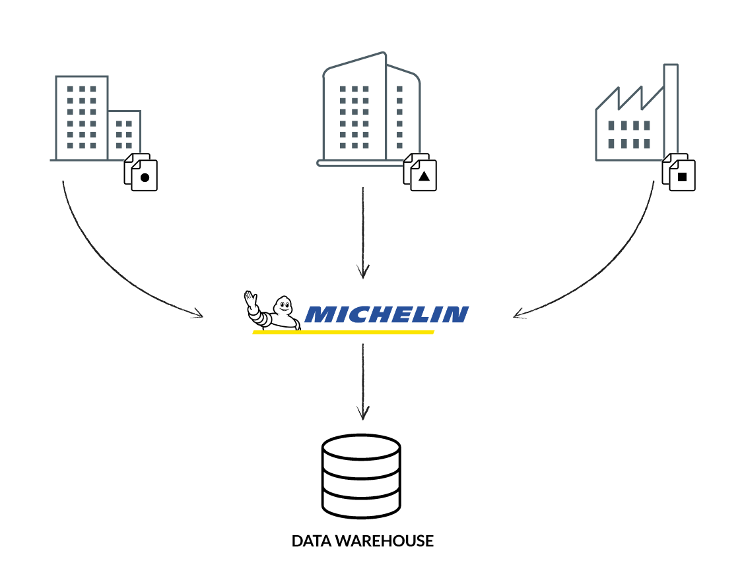
No EDI Process in Place
Large multi-national manufacturer
Situation: Organization has a large diverse set of distributers with no EDI solution for specific data requirements
Complication: Data comes into the organization in all types of formats; Excel, CSV, Flat Files, Access DBs, etc…
Need: Move the data securely into a company data warehouse and make it as easy as possible for partners to adhere to the integration solution
Solution: Build an API-based strategy to access data, transform and insert securely into the data warehouse
Notes:
Company had a lot of retailers it works with that were providing data that needed to be pulled into a data warehouse for planning, forecasting, etc.
Rather than go through a formalized EDI process and get all the retailers to adopt this, they wanted a more agile approach to be flexible enough to deal with customers in their current architecture

Slide 24
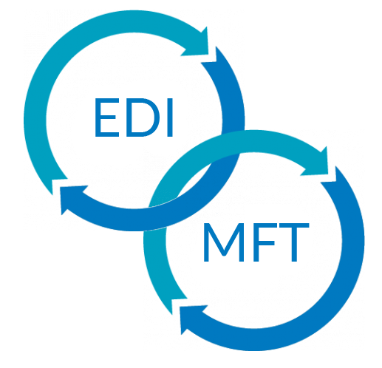
EDI VAN
Value-Added Network
Situation: Existing EDI solution has limited file transfer capability built-in to their platform
Complication: File transfer capability is built-in with their EDI solution and is not as robust and flexible as required
Need: Surgically remove the file transfer code from existing solution and replace it with a component file transfer service capability that can scale outside the core EDI application
Solution: Use a scalable and flexible integration platform with robust MFT capabilities that can be deployed on and off-premise
Notes:
File Transfer is not scalable
Was unable to support new technologies easily

Slide 25
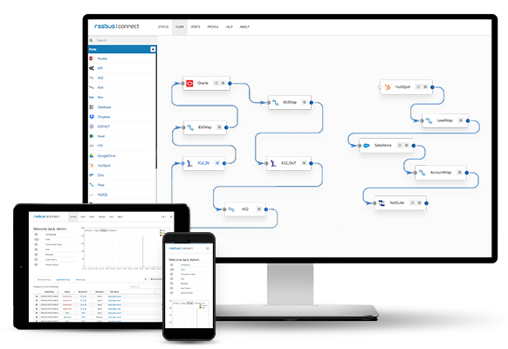
RSSBus Connect
Easy-to-setup, easy-to-configure, runs everywhere, universal connectivity
SIMPLE TO SETUP
Get started setting up your integration in minutes. RSSBus Connect helps you connect applications, files, databases easily through an intuitive drag-and-drop interface.
100+ Connected Apps & Growing
Largest number of supported data sources and connectors in the industry.
Flexible deployment
You can spin up RSSBus Connect with the click of a button on-premise, in the cloud, in a container, wherever you choose.
Deep Integration
Robust connectors that seamlessly support bulk operations, push-down, dynamic schema and metadata discovery, and unmatched performance.
Notes:
A little bit about what we do at RSSBus – we have a product RSSBus Connect that integrates applications and allows you to create workflows to move data between your trading partners and into your business.

Slide 26
Questions?
Email me at mikea@rssbus.com with any questions or feedback
Notes:
I hope you learned something. If you want to learn more about rssbus, contact me at mikea@rssbus.com

