Slide 1

Change Management for your Vendor Community:
Tips on Managing Through Process/Technology Changes That Affect a Large Portion of Existing Vendors
Josh Marder
Director Strategic Account Program
SPS Commerce
Notes:
HI Everyone, my name is Josh Marder and the topic of today’s conversation is solving the problem of wanting to introduce a new process or technology across your supply chain, I’m going to call this your “vendor community”, but having to face the reality that your asking many different and disparate organization to make a change, invest time, often spend money, to comply with this request and comply within your desired timeframe.
Sound like a fun way to start the day?
Let me better introduce myself. I come from a retail and supply chain background via IBM and Oracle, now at SPS Commerce as Director of the Strategic Account Program. Along with my SPS colleagues we implement 100s of these change management programs each year. My talk today is about sharing the best practices and realities of these endeavors, hopefully inspiring you to take the steps to roll out a highly beneficial new program to your supplier community that may being held up by reticence or confusion about how to deal the change across many other outside organizations

Slide 2
Change Management Events - Defined
Key Success Factors/Best Practices
Communication Strategy
Technology Strategy
Go-Live Strategy
Net New Suppliers
Q&A

Slide 3
Change Management Events
When a significant portion of vendor community is required to adopt new processes, technologies, or interfaces with Retailer (buying org)
Electronic Fulfillment
  Roll-out or widen participation in electronic fulfillment
  Introduce new/additional transactions, EDI documents, or requirements
Item Catalog Data – automate capture, validation, transformation of data
POS Analysis – fact-based recommendations from brands/suppliers
Notes:
A Change Management event is generally any time when the Retailer (or the buying organization for any manufactures or distributors in the audience) is asking your vendor/supplier community to adopt something new on your half, that involves new processes, technologies, or other ways of interfacing with your business. And that ask is going out to more than a handful of vendors, perhaps hundreds or thousands.
Let me give you a few examples. Under the heading of Electronic Fulfillment, a popular example would be either rolling out EDI for the first time and/or widening the participation beyond just the top x% of top vendors. Another fulfillment example would be introducing new transactions or requirements, like rolling out Advanced Ship Notice, PO Acknowledgement, or a PO Change process to the existing base.
I’ll give you a couple of non-EDI examples. Item Catalog Data. I’m not talking about EDI 832 but rather about automating the process many retailers here have for suppliers to provide detailed item attribution and images. The similarity to my EDI example is that vendors are being asked to participate in an electronic exchange of information in a structured one-to-many approach to address all of their trading partner’s needs. Only now its about product attribution and media, the details that cover ordering accuracy, warehousing logistics, regulatory governance, and product presentation.
One more example is managing the process of getting your major brands and suppliers to provide fact-based recommendations which requires both a common platform for analyzing sales and inventory data as well as a way to collaborate on the insights that a brand can often bring to the retailer's merchandising org to improve sell-through and inventory positions.
Given the audience here, I’m going to stick to electronic fulfillment as my main example for the rest of this discussion, but I think you got my point that this can apply to other situations where you’re trying to better collaborate with the vendor community.

Slide 4
Challenges to Overcome
Limited retailer resources
Supplier resource constraints and priorities
Variety of technology investments in supplier community
Large communication burden
Simultaneous supplier implementations/tests
Post-go-live shake out
On-going compliance
Notes:
OK, sounds like some good goals. Let’s go straight to the challenges that are probably already popping into your heads.
I as the retailer or any other buying org looking at my supplier community have limited resourced allocated to functions like vendor management and fulfillment, And here we are talking about significant widening of participation that it may have taken years to get to our current point.
Ditto the supplier who is always getting requests from the people who are selling their wares to improve electronic fulfillment. Often a backlog develops.
Looking across the supplier community where we’re asking for compliance to a set of technical requirements, the reality is that there is a very large variety of existing technology and capabilities. Each supplier’s situation is at least somewhat unique.
How about the shear communication burden? Just reaching out to a list of hundreds or thousands of suppliers is onerous, let alone having detail conversations about requirements and steps to certifying compliance.
Then suppose you get most trading partners to commit to your new program, now they are all going to, somewhat simultaneously. Implement whatever steps each one must take to be Production Ready.
Even after everyone has tested or otherwise achieved a certification of production readiness, the day comes when they all start reacting to that first electronic PO or send their first electronic inventory advice to your production system. This immediate post-live period requires intense care as it shakes out.
Lastly, a highly-compliant vendor community can devolve as time goes on, supplier personnel turn over, and life goes on.

Slide 5
Discipline of “Community Enablement”
Change Management for Supplier interactions
Campaigns to reach out to supply chain community
Present the value proposition
Consultation on each supplier’s situation – path to compliance
Agreement to move forward
Remove obstacles
Coordinate implementation
Notes:
So let me introduce a trend that many of you will want to pay attention to: the discipline of “Community Enablement”.

Slide 6
Maximize Adoption
Minimize Disruption
Notes:
I’m talking about the twin goals, and somewhat opposing goals, of maximizing adoption of your new program or process while simultaneously minimizing the disruption to BOTH the supplier and the buying organization.

Slide 7
Best Practices
Five Key Success Factors

Slide 8
Best Practices to Drive Success
Defined
Business Value
Quality trading partner information
Merchandising Sponsorship
Clear and Reasonable Requirements
Escalation Management

Slide 9
Merchandising Sponsorship
Retailer executive that owns supplier relationship is informing suppliers of requirement to participate in this program

Slide 10
Defined
Business Value
What is the Business Case for Change? Establish STRONG messaging around WHY these requirements are IMPORTANT to you and your suppliers. What is changing? Why now?
Clear articulation of value to suppliers.

Slide 11
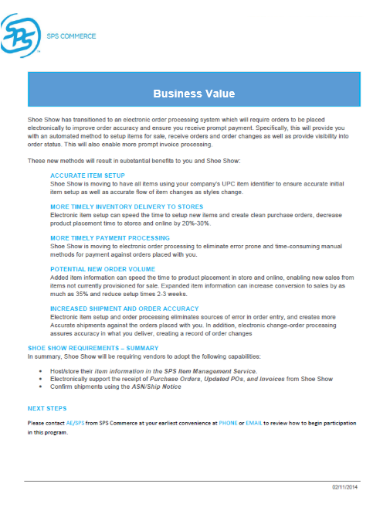
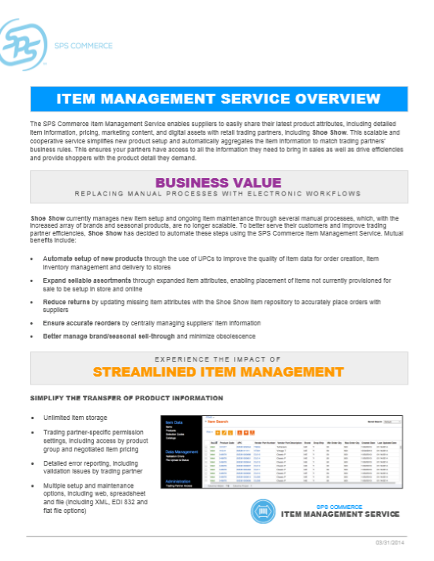
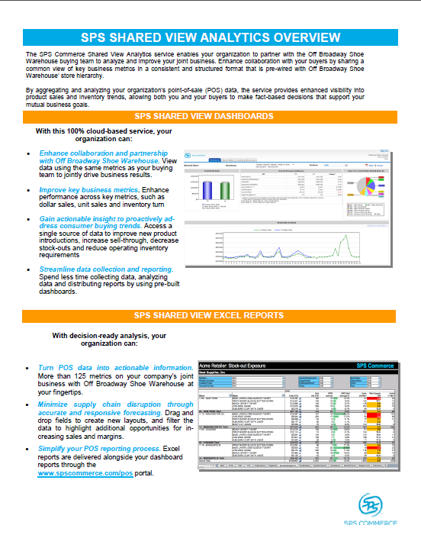
Written, Business Case-Driven, Value Propositions
Accurate Item Setup
Timely Inventory Delivery
Shipment Accuracy
Expand Sellable Assortment
Increased Order Accuracy
Insure Accurate Reorders
Increase Sales
Optimize inventory level by location
Improve margins

Slide 12
Clear and Reasonable Requirements
Align requirements with industry standards.
Eliminate vagueness or unusual requirements as reasons not to participate.

Slide 13
Quality trading partner information
Quality information helps expedite the DECISION MAKING process
Contact info (name, email, phone)
  Often times not readily available
Order Activity (PO#, PO$)
Purchasing Manager/Buyer
Requirements by Vendor

Slide 14
Escalation Management
Exception-based process to manage objections or business questions.
A 24-hour response is critical for momentum.
Use pre-approved email templates for initial responses.
Some direct outreach by merchant may be required.

Slide 15
Vendor Reactions
predictable
30-40%
No Questions Asked
40-50%
Willing, But “Challenge” Your Business Case
10-20%
Vocal Resistors
10%
Unpredictable

Slide 16
Escalation Examples
Reason | Description | Retailer’s Action
Verbal or Written Decline | Vendor has stated that they will not comply. | Send email template reinforcing expectations.
Asking for an extension | Vendor is stating they will move forward at a later date. | Send email template reinforcing the deadline.
Clarification Needed | Vendor has a question, concern or objection that needs addressed before they proceed. | Send email template addressing issue and reinforcing expectations.
No Movement | Vendor has not made a decision after multiple attempts. | Send email template reinforcing expectations.
Bad Data | Includes vendors we are unable to contact or are no longer doing business. | Review vendor information.

Slide 17
Communication Strategy

Slide 18
Start with Buyer Awareness
Announce a Formal Initiative
Value Proposition to Retail and Supplier
Program Requirements
Supplier Costs
Artifacts like Supplier Microsite
Anticipate “informal” inquiries
Notes:
Debunk a lot of myths.

Slide 19
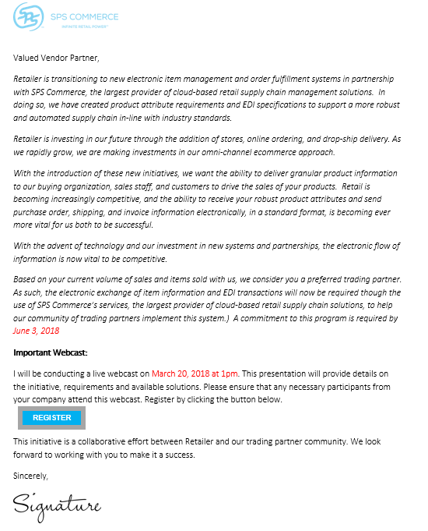
Program Announcement
Initial external communication from Head of Merchandising to trading partners
Promote an “Event” where details will be presented
Give audience time to put event on schedule

Slide 20

Webcast
Head of Merchandising will communicate business reasons/drivers for Retailer
Communicate value to suppliers
Communicate requirements, timelines and expectations
Explain role of Community Enablement

Slide 21
Communication Schedule
Kickoff Supplier Announcement Email
Commitment Deadline
Production-Ready Deadline
Buyer’s Education
Webcast
VENDOR OUTREACH
IMPLEMENTATION
Week | 1 | 2 | 3 | 4 | 5 | 6 | 7 | 8 | 9 | 10 | 11 | 12
Deadline Approaching
Deadline Approaching
Deadline Friday
Deadline Friday
Deadline Tomorrow
Deadline Tomorrow
Past Deadline & Thank You
Past Deadline & Thank You

Slide 22
Technology Strategy

Slide 23
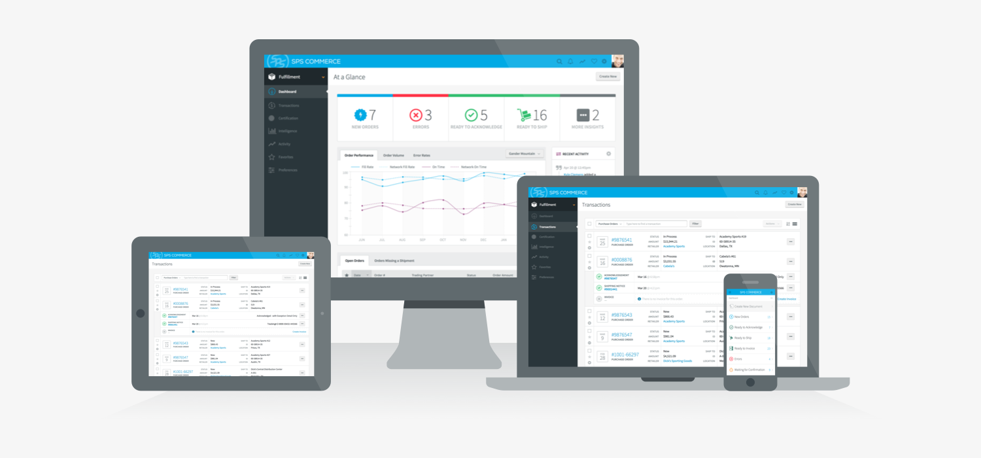
    Have a pre-certified, web-based, low-cost option available.

Slide 24
Use an Automated Testing Tool/Service

Slide 25
Go-Live Strategy

Slide 26

The Last Mile – Post Go-Live
People:
Community Operations
One Lead
Hypercare Specialists
Subset of normal Support
Process:
Rapid issue closure
Proactive Monitoring
Additional Reporting & Visibility
Weekly Operational Reviews
New Vendor Onboarding
Notes:
Last Mile is effort to fully operationalize the solution
Need to go in and unpack the damn groceries for them – that is an army of people from SPS
We have invested significantly in resources in this last mile – that sit on top of these relationships as they go live and drive insights, trends, recommendations to get them to that operational state
They become addicted to it, can’t live without it
Addiction creates that revenue stream grows exponentially.
Today – ask Jess to come up and speak to one of those roles - Community Consultant
Jess
One of the things we recognized in implementing retail communities on the supplier side was that we had established a strong relationship with the supplier BUT this was a bit of a one way conversation.
We consulted and enabled suppliers to do the business the way the retailer requires BUT the 150+ folks implementing for these suppliers --
we didn’t have a voice, a way to consult, or way to make recommendations to out partner.
This became the vision of the community consultant.
The Community consultants are that voice from the suppliers as we are implementing the community. We help the retailer understand the supplier experience, mitigate escalations from their suppliers, and drive to high adoption rates.
This role has had an impact.
We have been able to recommend ways to engage the community, provide greater visibility, align and educate to our internal army of implemnetors , and report on slow moving or inactive customers leading to higher community adoption.

Slide 27
Net New Vendors

Slide 28

Community Enablement is On-going
Change Management
# of Trading Partners
Change Management
New Vendor Onboarding
Months
Notes:
So as you can see, we’ve got a lot of experience in working with buying organizations and their business partners. One thing we’ve learned to do is to create effective programs to drive adoption. We call this our community enablement. And, we’ve seen two types of programs – large change management where you are driving compliance, and ongoing onboarding for new vendors.

Slide 29
Conclusions
Build or Buy a Community Enablement discipline
Use Community Enablement for a variety of supplier-focused initiatives
If considering EDI outsourcing, change your definition
  All on-boarding and change management
  On-going supplier compliance
  Maintenance of all supplier connections
Don’t fear the long tail
Expect high participation in a mutually-beneficial trading relationship

Slide 30
Josh Marder
jcmarder@spscommerce.com
C: 603.818.9832

