Slide 1



2016 Job Market Overview
National 2016 job market update, EDI market update, Hot EDI and IT positions, salary statistics
Employers: Tips for attracting top talent, best practices for rewarding and retaining employees
Job Seekers: Tips and Techniques that will
get you noticed and hired!

Slide 2
EDI Specialists Overview
EDI Specialists founded in 1994, headquartered in Raynham, MA
2 Key Divisions: EDI Staffing and KeyIT
Perm and Contract placement coverage for EDI-EAI-EC-IT
Clients range from small start ups to Fortune 100 spanning all industries in US and Canada
Offices - Maine, Texas, California, Massachusetts, Ontario
Super large database of active and passive professional EDI and IT resumes

Slide 3
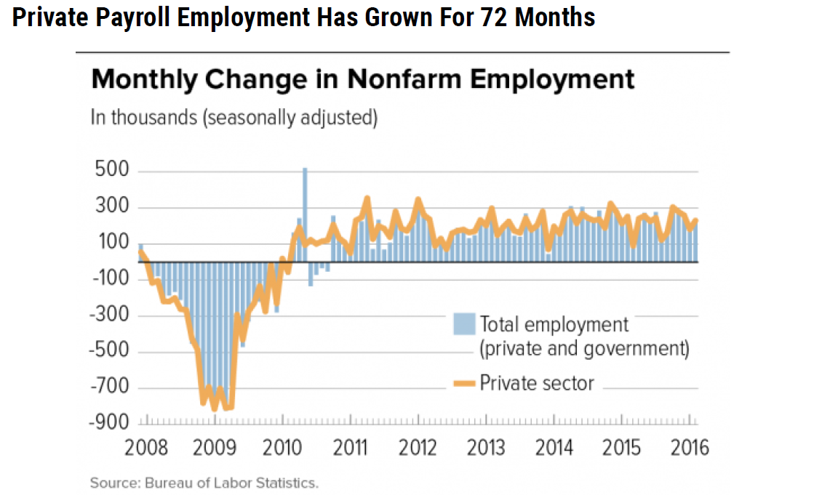
Current Job Market
Companies are Hiring!!

Slide 4
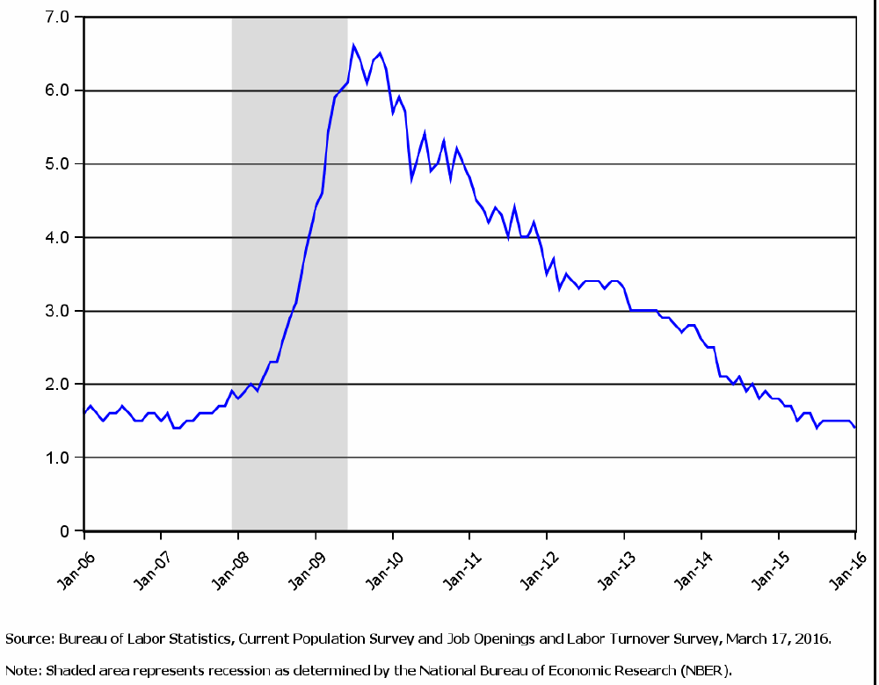
Current Job Market
Number of unemployed people per job opening

Slide 5
Current Labor Market Stats
  10% National Unemployment Rate– December 2009
  6.3% National Unemployment Rate – May 2014
  5.0% National Unemployment Rate – March 2016
  New England Unemployment stats:
    5.7% Connecticut Unemployment Rate – March 2016
    5.4% Rhode Island Unemployment Rate – March 2016
    4.4% Massachusetts Unemployment Rate – March 2016
    3.4% Maine Unemployment Rate – March 2016
    3.3% Vermont Unemployment Rate – March 2016
    2.6% New Hampshire Unemployment Rate – March 2016

Slide 6
Current EDI and IT Job Market
Since the 2008/2009 Great Recession, EDI and IT hiring has gradually increased year over year!
A candidate’s market: number of EDI and IT job opportunities > number of available and qualified candidates

Slide 7

What’s driving the EDI hiring?
Economic Growth – Companies doing more business!
The EDI Baby Boomers are beginning to retire
    Difficult to replace due to experience and skill sets
Major Increase in amount of health-care and insurance related mandates, processes, and standards: Affordable Care Act, HIPAA, PHI, ICD-10, Electronic Records, etc.

Slide 8
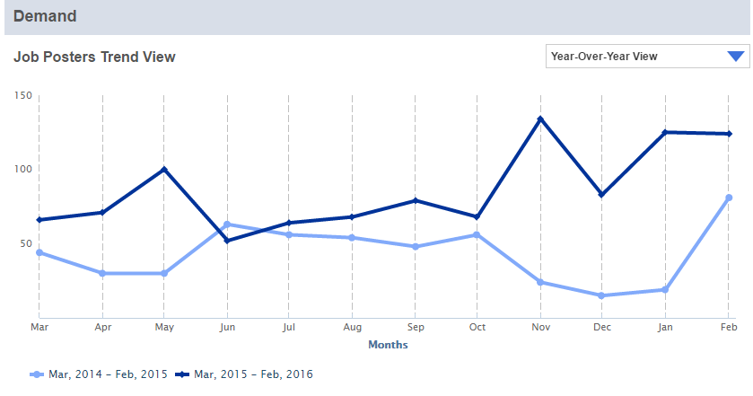
53.1% increase in BizTalk contract and perm jobs!!
February 2015-February 2016
CareerBuilder Data Portal

Slide 9
The EDI ‘hot’ list – Contract
  BizTalk 2010 – 2013
    Architect - $$$$ $100 - $160/per hour
    Developer - $$$ $75 – 120/per hour
  IBM STERLING B2B INTEGRATOR
    SI Mappers - $$$ $75 – $110/per hour
    SI Architects - $$$$ $100 - $175/per hour
      GIS to SI Upgrade Architects
      BPML Experience a major plus
  Gentran – Windows, Unix, and Mainframe
    Mappers and Developers - $$$ $70 - $90/per hour
  OpenText - GXS Application Integrator, Biz Products
    Mappers and Developers $$$ $85 - $125/per hour
  EDI Business Analysts – $$$ $70 - $90/hour

Slide 10
The EDI ‘hot’ list - Perm
EDI Perm Positions – New England:
  EDI Coordinator - $$
    50K – 65K
  EDI Business Analyst - $$$
    70K – 95K
  EDI Mapper/Developer/Architect - $$$
    75K-125K
  EDI Manager - $$$
    80K – 125K

Slide 11
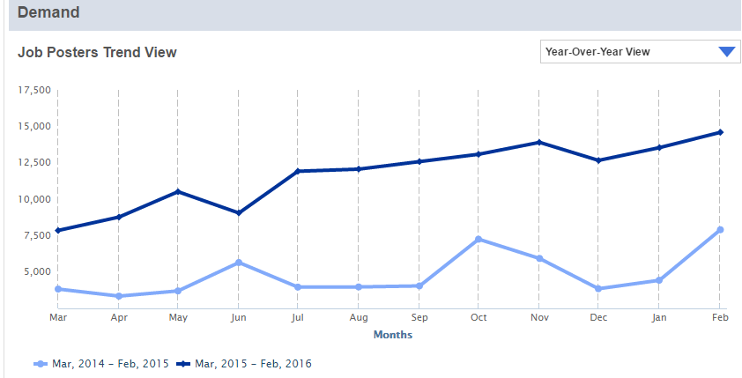
In-Demand IT positions
Demand for cybersecurity professionals grew 3.5 times faster than demand for other IT jobs since 2011 –Peninsula Press
Cyber security and Information Security market expected to grow from $75 billion in 2015 to $170 billion by 2020- Forbes Tech
73.5%+ job posting change from February 2015-February 2016
CareerBuilder Data Portal

Slide 12
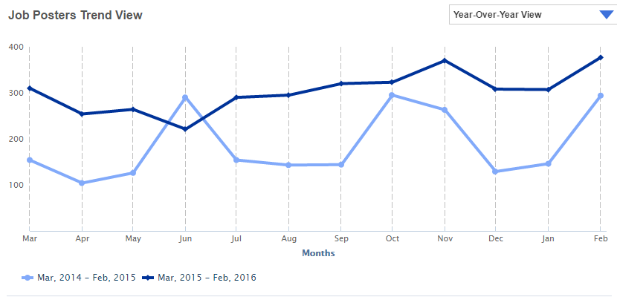
In-Demand IT positions
28.2% + Change in Mobile App job postings from February 2015-February 2016
CareerBuilder Data Portal
(CareerBuilder Data Portal)

Slide 13
The IT ‘hot’ list
Microsoft SharePoint Developers/Architects
ERP and Middleware solutions to include Oracle, SAP
    SAP prevalent in many CT and NH based companies – SAP SD, SAP BW, SAP BI, SAP FICO
Quality Assurance Engineers
Anything and Everything ‘Data’ – Data Warehouse, Data Mining, Big Data, Data Analytics, etc.

Slide 14
Types of open positions – contract and perm - National
89%
82%
Significant Increase in EDI Contract positions past 2 years
  ***New England/NY/NJ leads US in # of EDI Contract position
Decrease in IT Contract positions in past 2 years
Contract to Perm positions remain the same

Slide 15
Looking to Hire?
How to Attract the Ideal Candidate…

Slide 16
Write an Attractive Job Description
Craft a ‘compelling’ job title
Be realistic in your expectations!!
  Don’t Double or Triple Up on ‘un-related’ skill sets
Be as specific as possible in outlining skills needed
  Clearly List ‘MUST HAVES’
  Clearly List ‘ Preferred’
Include a company overview, department overview, and why the company is an excellent place to work
  Include company/employee benefits and perks
Include salary ranges and benefits
  Ensure the salary range meets market expectations

Slide 17
Effectively Screening Candidates…
Technical Contract Positions
  After initial phone screen:
    Conduct a SKYPE technical interview
    Give candidate a skills assessment task
    If contractor will be remote, contact minimum 2 references
Technical Perm Positions
  After initial phone screen:
    Bring candidate in for an in person interview
    Give candidate skills assessment task
    Contact at least 3 references

Slide 18
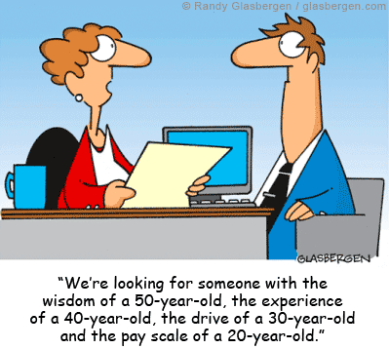
It’s a candidate’s market – Don’t scare a good candidate away!!

Slide 19
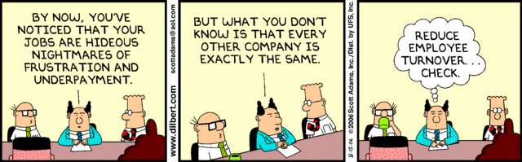
Once Hired – Keep Them!!

Slide 20
How to Retain Top Performers
Communicate REGULARLY with your employees!
  Be approachable - Open Door policy
  Conduct ‘Stay’ Interviews
Recognize Accomplishments
  Design a Formal Employee Recognition Program
    Make the goals attainable
    Make the rewards known
  Acknowledge the ‘little’ things always and often
Ensure there is a desirable growth path
  Promote from within!
Always pay market rate – especially for top performers!

Slide 21
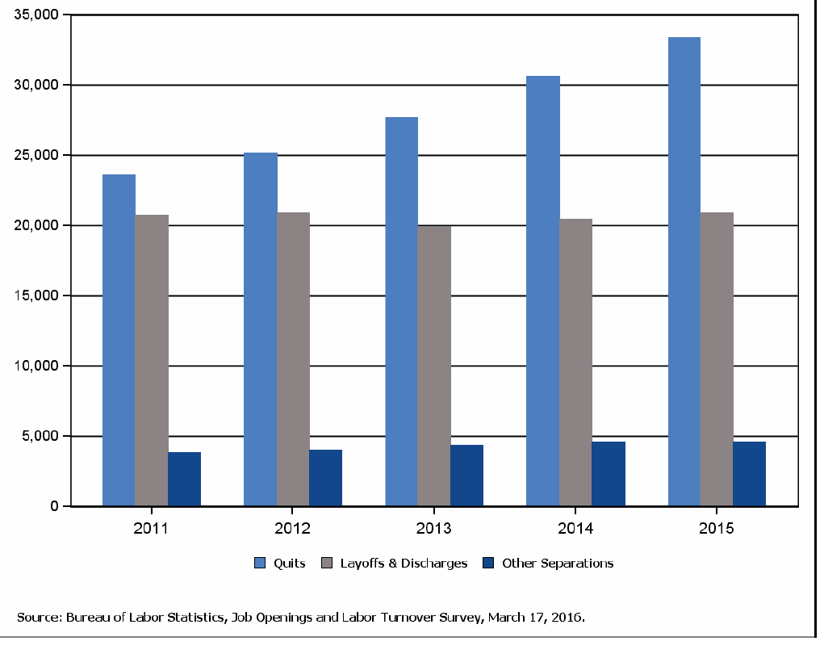
Is it time for a change?
Calling it Quits!!
The number of ‘Quits’ rose in 2015 for the 6th consecutive year!!

Slide 22
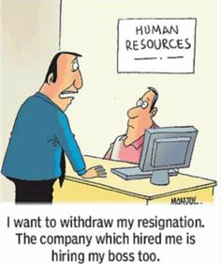
Top Reasons that people leave their jobs!
Unhappy with their boss!! - #1

Slide 23
Top reasons people change jobs!!
Unhappy with their boss- #1
Work not interesting/challenging - #2
Better Compensation - #3
Better Work – Life Balance - #4
  Flex hours, work remotely

Slide 24





If You are a Job Seeker…
Living in an era of unprecedented transparency for finding job related information
  Most job opportunities are viewable online, and the available online content– i.e. information on the company, culture, salary, hiring manager, benefits, etc. – has never been richer
Social Media job search tools and talent acquisition platforms are everywhere…. its no longer just Monster and Career Builder

Slide 25

Seeking a job….
WHAT WILL MAKE YOU STAND OUT??
http://www.flickr.com/photos/linkhumans/

Slide 26
Creating a Stellar Cover Letter
Showcase your interest in the company/position as well as your best attributes for the position
Always customize and tailor to the position
  ‘Pull out’ 2 – 4 key skills from the job description and show you have them
Proofread carefully
  Consider getting a second pair of eyes
  Ideal length – 2 - 3 paragraphs

Slide 27
RESUME Don’ts
RESUME OF HARRY HURTSMYEYES
***EMPLOYERS WILL GIVE THIS RESUME A 20 - 30 SECOND INITIAL LOOK…..WOULD YOU WANT TO READ THIS?
Objective
Strong IS professional looking for an Application Support Analyst position where I can utilize my critical thinking skills, business infrastructure and relationship experience.
RECENT WORK HISTORY
ABC Company - Providence, Rhode Island 06 to 4/2013
Service Manager IS Specialist/ Project Coordinator – Support Information Systems infrastructure hardware, software and company products for the Blue Cross Blue Shield account. Oversee and Manage BMC Remedy CRM Action Request Software, OPAS Administration, Incident, Problem, Request, and Configuration Manager, Asset Management Responsibilities. Drive all End of Month activities ensuring accuracy in meeting SLO objectives reported with integrity. Provide senior management and communicate regularly with C Level executives.
Participate in all client meetings with weekly status reports regarding minutes and meeting end of month SLO targets.
Ability to manage escalations, outages, significant issues concerns while working closely with internal members engineers and providing consistent communications to clients. Facilitate Daily Operations meetings, which assess severity 1 and 2 incidents from the previous business day, as well as, ensuring correct configured items are reported accurately with operations or engineering groups, daily backups and their reporting successes or failures, daily changes and aging Incidents. Facilitate weekly change meeting, coordinate technical and admin support activities. Validate each change and review back out plans, ensuring software applications, hardware platforms or mainframe activities do not conflict.
Keep account updated with corporate activities. Coordinate projects, assign action items and follow up with Tower Leads, Project Managers,
C Level Executive Management ensuring plans executed accordingly. Facilitate Problem review meetings with IS and ADM, identify root causes; ensure action items are determined, deliverable dates and owners are established driving each problem to a resolution.
Create and update account documentation, workflows as need using Microsoft Office Applications and Visio. Enforce polices and ensure procedures are being adhered to.
Identify opportunities and drive steadily achieving solutions at the same time, challenge existing paradigms as needed. Established an Incident Life Cycle process for the account utilizing ITIL best practices streamlining operations, workflow chart with hypertext links to procedures to address situations depicting progression flows from when an incident occurs to when it is closed. Reduced inventories of Incidents, Aging Incidents, Problem Records, and Aging Request tasks by 70 percent.
DEF COMPANY Providence, Rhode Island 01/2005- 6/30/2006
Manager – Client Services/Network Operations/Wireless Communications - Manage and direct internal/external resources driving each issue to closure. Work with sales and engineering on new existing and implementations. Implemented 24x7 out sourced call center. Over see daily operations along with documentation, training for 1st and 2nd level engineering and procedures addressing different issues during escalations. Ability to manage escalations, outages, significant issues, concerns while working closely with internal members engineers and providing consistent communications to clients and C Level executives. Work with systems engineering, field engineers on technical issues and ensuring CRM application is current meeting our changing needs. Manage 1st, 2nd, & 3rd level incidents. Establish action plans and set or re-baseline expectations with each issue. Issue credits where necessary and address SLAs questions to expectations along with equipment replacements if needed. Negotiate contract terms, labor rates, and SLAs with new vendors meeting company requirements. Communicate regularly with C Level executives; participate in all client meetings and visit customer locations when needed.
HIJ Corporation Dover Massachusetts 1/2004-05/2005
Regional and Global Escalation and Customer Service Manager for South America – Proficient in utilizing Clarify CRM in monitoring case progression and all Microsoft applications. Responsibilities act as a focal point for escalated issues. Adapt action plans and expectations for solving complex service related problems during different severity levels. Manage and direct internal/external resources driving each issue to closure. Coordinate war room environment as the focal point for EMC, customer, and partners. Ability to manage escalations, outages, significant issues concerns while working closely with internal members engineers and providing consistent communications to clients Coordinate RCA’s, FA’s and Mechanical replacement as necessary. Write and present turnover reports to executive management entailing shift activities. Communicate regularly with C Level executives, participate in client meetings. Interface with Senior Management, Engineering, Sales, Marketing, TSG and Customer Services, in addition, to coordinating technical resources between the field, Global managers, and Partners to resolve business, support and technical issues. Work closely with Sales, Planning, Logistics, and Engineering organizations on new implementations. Provide recommendations for improved product serviceability and reliability and revenue opportunities as well as ensure SLA’s are being met. Traveled to Brazil and Miami meeting with customers addressing their issues and concerns.

Slide 28
More Resume Don’ts
Don’t create a resume greater than 2 pages
Don’t include a job where you worked 3 or less months unless you are a temp worker or contractor
    If you have large gaps in employment, consider listing volunteer positions to fill the gaps
Don’t show your last position as ‘present’ if you are no longer working
Don’t include your employer company’s description summary

Slide 29

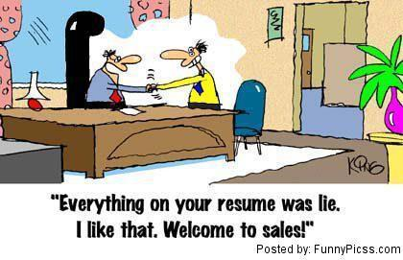
Don’t be part of The ‘Pinochio’ epidemic!!

Slide 30
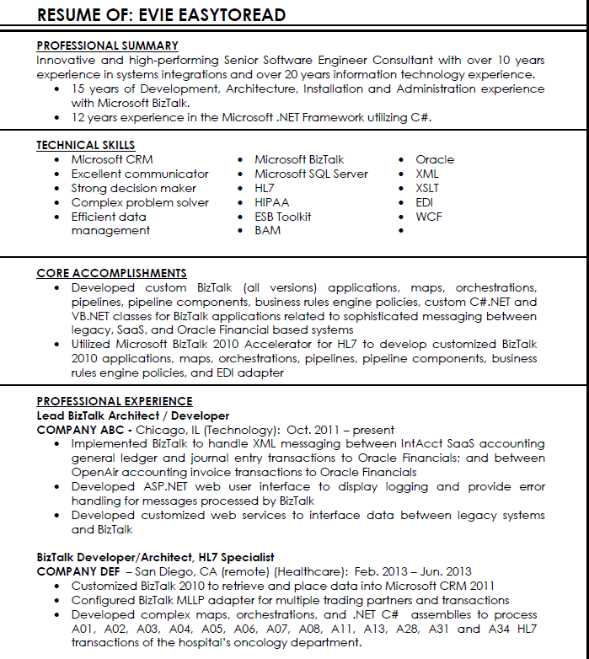
RESUME Do’s…

Slide 31
More Resume Do’s
“Tweak’ the resume based on the job you are applying for
Organize and Present a Clear and Consistent Hierarchy of Work Experience and Accomplishments
  Include ‘Applicable’ Recognition Awards, Accomplishments, Honors, Certifications, Quota achievements, etc.
  Include your formal education history (college level and up) and list all degrees earned
Proofread and SPELLCHECK!!
Reference your LinkedIn Profile

Slide 32
Keep LinkedIn profile up to date
  Fill out as much information as possible
  about your background, career, skills,
  education, publications, awards, etc.
  Keep Profile Consistent with Active Resume
  Post a professional photo
  Create a ‘relevant’ profile title
  Join Groups - Post Discussions in Forums
238 million+ LinkedIn users
1.6 million
LinkedIn groups

Slide 33
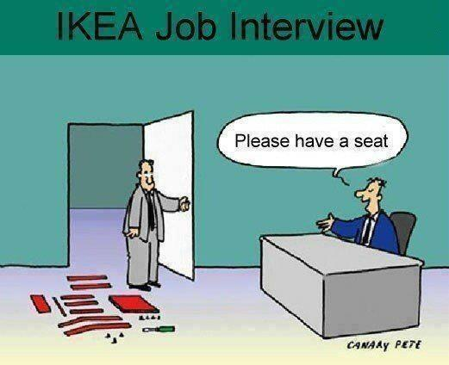
You Got the Interview!!!
Be Prepared and Research!!

Slide 34
Ways to ACE Your Interview
Be able to answer the question ‘ Tell me About Yourself’
  How are your skills/experience relevant to the job description
Be able to clearly explain everything listed on your resume
  Focus on your Accomplishments
  Discuss how the interviewer’s org. can benefit from your skills/experience
Stay calm and don’t get flustered when/if you are asked difficult questions
  Understand your red flags – know how to lower them
  Be honest and sincere
  Be Confident!
Prepare great questions to ask

Slide 35
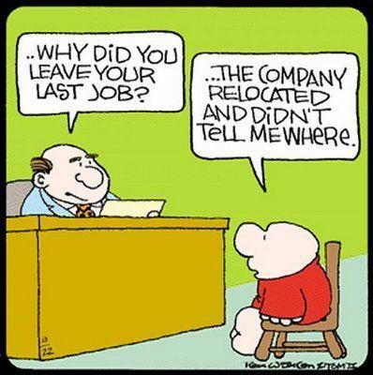
Ways to ACE Your Interview
Be Prepared to Answer Every Job Transition Question!!

Slide 36
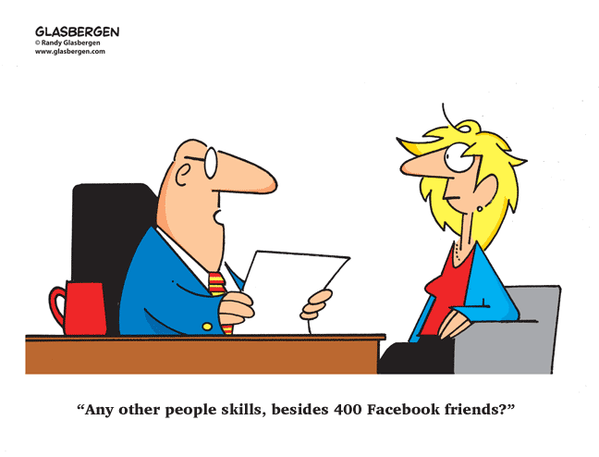
Ways to ACE Your Interview
Show off your ‘soft’ skills!

Slide 37
Remember….What you say is not always what they hear…
  https://www.youtube.com/watch?v=UkSfp3XHSko

Slide 38
What to do post interview – thank you and references
Follow up within 24 hours of interview!!
  75 % of interviewers said that receiving a thank you or follow up email or letter from a candidate impacts their decision-making process.
‘Prep’ Your References
  Provide at least 1 - 2 former managers or supervisors
  Make sure you give references a heads up they will be getting contacted
  Make sure you references know enough about what you did in your former roles
Expect a background check and drug test

Slide 39
Tips for Negotiating An Offer
Begin with Cash Compensation/Salary first
  Be Realistic – know your worth!!
  Use Your Company Research and Inside Information
  Has the company been flexible in the past with benefits?
  Are there exceptions to Vacation Days/PTO?
Get ALL Offer Changes in WRITING!!
  Offer letter
  Benefits Package
Remember…You Can Always Reject the Offer!

Slide 40
Were You Paying Attention??
What was the name of the person on the Resume Don’ts??
  HARRY HURTSMYEYES
What was the name of the person on the Resume Do??
  EVIE EASYTOREAD

Slide 41
Questions?

Slide 42

Thank You!!

