Slide 1
The Next 20,000 Hubs
NEECOM - May 11, 2016 Todd L. Gould, CEO

Slide 2
First, a Quiz
What Is This?
Answer:
Asterik
Asterisk
Star
Splat
Misunderstanding?

Slide 3
EDI Is Dead, Long Live EDI
Critics Everywhere
EDI Is Here to Stay
Can’t compete with the Internet
XML will replace it
Orphan Technology
It’s as old as the Internet
The original B2B eCommerce
Backbone of Supply Chain
Deregulated Energy
Healthcare

Slide 4
Who Uses EDI
How many EDI users?
Guesses?
Hubs?
What’s a Hub?
Spokes?
Any Spokes in the House?

Slide 5
A Quick EDI Innovation History
1970s – The Idea
1980s – The VAN
1990s – The Interconnect
2000s – The ECSP
2010s – The ?

Slide 6
What Went Wrong?

Slide 7
The Technology Adoption Life Cycle
Innovators
Early Adopters
Early Market
Late Market
Laggards

Slide 8
Where Are We Now?
How Do We Define the Market?
It’s All About the Hub
Can’t have Spokes without Hubs

Slide 9
It’s All Perspective
“EDI will become ubiquitous when everyone feels like a Hub and acts like a Spoke”
- Todd Gould, 1999

Slide 10
We Need More Hubs!
Hub
Hub
Hub
It’s Good to Be the Hub
More Hubs = More Spokes
Convert Spokes into Hubs = More Hubs
Lather, Rinse, Repeat
Like Social Networking
We have a growing market!
But what’s going on?

Slide 11
The Chasm
Geoffrey Moore
Crossing the Chasm
Inside the Tornado
Before - Technology
After - Products

Slide 12
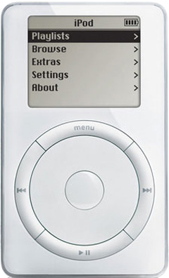
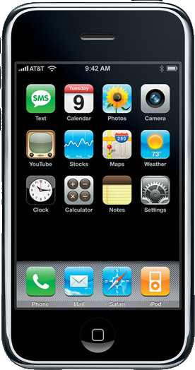
Apple
iPod
iPhone
MP3 Player
Hundreds
Shapes
Sizes
iTunes
Smartphone
Kyocera 6035
Treo
BlackBerry
App Store

Slide 13
IBM
The Venerable PC
Allowed users to do it themselves right out of the box
No longer required an IT department
It is all about the Apps
WordStar, Lotus 1-2-3, dBase
And the Network
Netware, Windows for Workgroups

Slide 14
The Whole Product
Solutions! (not Tools)
Early Adopters like Technology
Looking for competitive advantage
Core to their mission
Tinkerers
The rest of us need Products
Trying to not fall behind
Context to our businesses
No time to waste

Slide 15
The EDI Chasm
Early Adopters
Automotive
Retail
Energy
Tools, Tools, Tools
Map/Trans
Communications
Web Forms

Slide 16
The Failed Leap Across the IT Divide
Technology for Hub
Hubs created the blueprints
Providers delivered tools
Spokes burdened with building the bridges
Dysfunctional Market

Slide 17
Learning from the Past
What Worked?
What Failed?
EDI!
Interconnects (yes!)
The Internet
EDI Service Providers
AS2
Implementation Guides
Tools
Value Added Networks
AS2
=
Trading Partner Enablement
= Hub Enablement

Slide 18
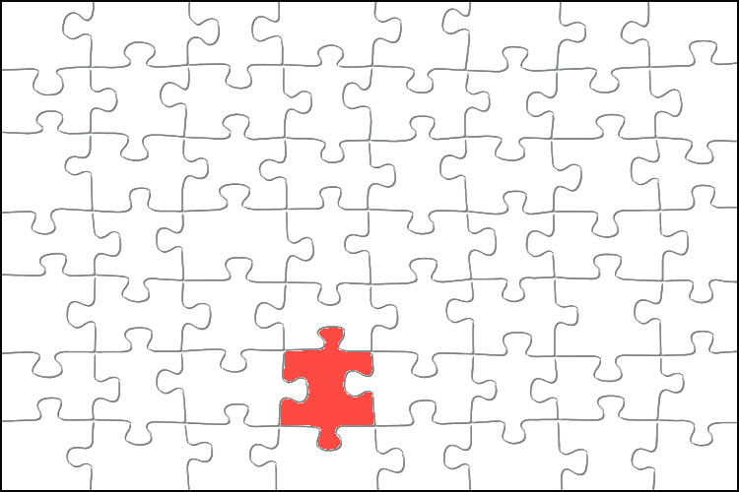
Most of the Pieces Are Here
Midmarket Enterprises
Spokes Are Easy
200,000 - $50m - $1b
Familiar with EDI as a Spoke
“Alt-ERP” in Place > 60%
Internet-Protocol Ready
Web Services
VANs and Interconnects are in place
Electronic Commerce Service Providers (ECSPs) are in place

Slide 19
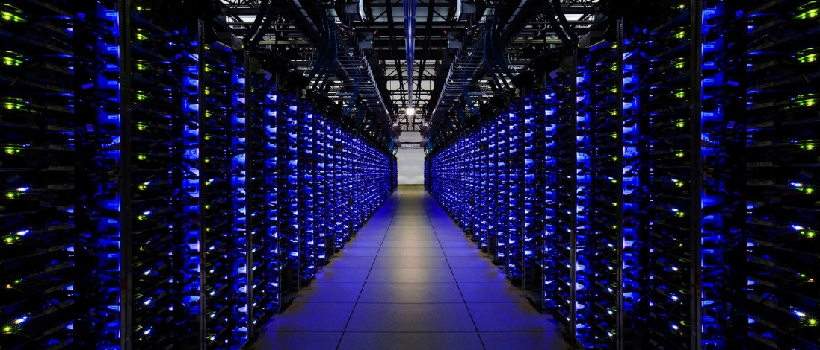
The Missing Links
Directory Services
Semantic Documents
“EC-ID”
System/Communications Independent
Automated
Business objects not Syntax
Expressed in Multiple Ways
Backwards Compatibility

Slide 20
Float Across on a Cloud
Products for Peers
Community-Based Business Documents
Shared, Global Directory
Vibrant, Cooperative, Innovative Market
Benefits shared by both sides of trading partnership

Slide 21
Now It’s All Up to You
In this Room Are the Leaders

