Slide 1
GS1 Standards in Apparel and General Merchandise
Creating Supply Chain Synergies to Meet Omni-Channel Consumer Expectations
Susan Pichoff, Sr Director Community Engagement
May 22, 2019

Slide 2
Antitrust Caution
GS1 US® is committed to complying fully with antitrust laws.
We ask and expect everyone to refrain from discussing prices, margins, discounts, suppliers, the timing of price changes, marketing or product plans, or other competitively sensitive topics.
If anyone has concerns about the propriety of a discussion, please inform a GS1 US representative as soon as possible.
Please remember to make your own business decisions and that all GS1 Standards are voluntary and not mandatory.
Please review the complete GS1 US antitrust policy at:
www.gs1us.org/gs1-us-antitrust-compliance-policy

Slide 3
Today, we’re going to….
GS1 US Overview
Product Images and Data Attributes Guideline
Order Consolidation Guideline
RFID
Blockchain
Questions

Slide 4
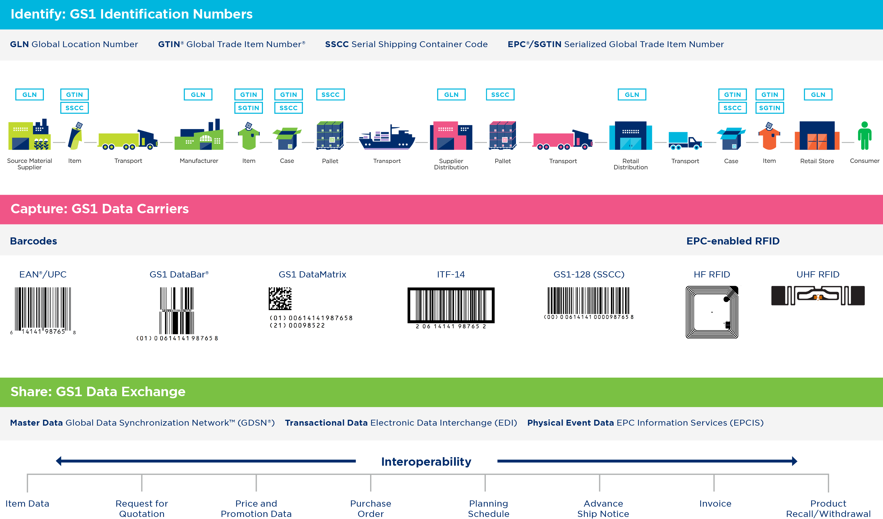
GS1 Standards in Apparel and GM

Slide 5
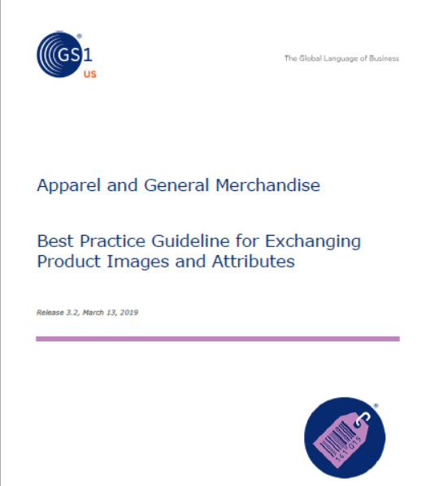
Images and Attributes
Best Practice Guideline for Exchanging Product Images and Attributes, Release 3.2
Provides detailed guidance on how to create, manage and supply product images and data attributes for use in commerce applications across retail operations
Learn more
www.gs1us.org/industries/apparel-general-merchandise/implementation-resources/best-practice-guideline-for-exchanging-product-images-and-attributes

Slide 6
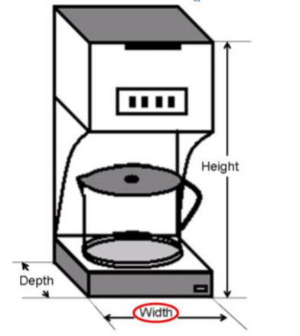
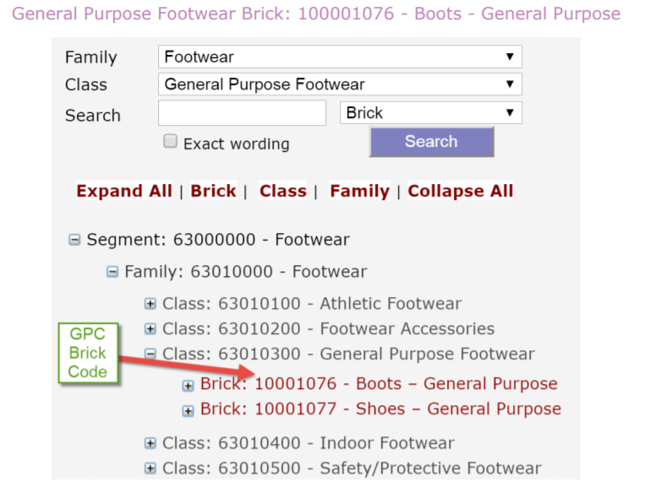
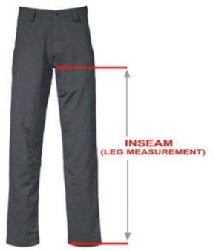
Guidelines Give A Clear Direction To Trading Partners

Slide 7
Detailed information on Attributes and Values

Slide 8
EDI Guidance on Sharing Data

Slide 9
New Order Consolidation Best Practices

Slide 10
2 ways to Share OC data via EDI856
Retailer Consolidates
Brand Owner Consolidates

Slide 11
Brand Owner Consolidates
Uses SPOI structure : Shipment, Package, Order, Item
BSN (Beginning Segment for Ship Notice) where BSN05 =0003 (Shipment, Packaging, Order, Item)

Slide 12
Retailer Consolidates
Requires no special formatting

Slide 13
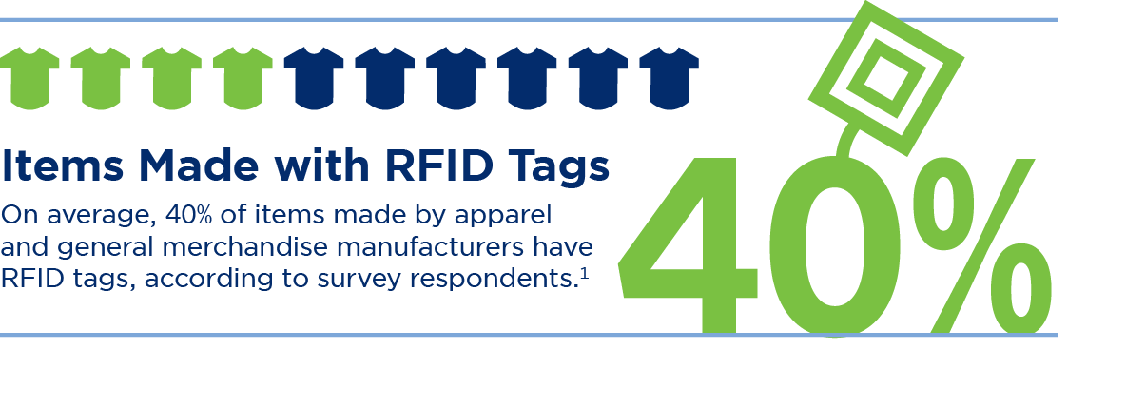
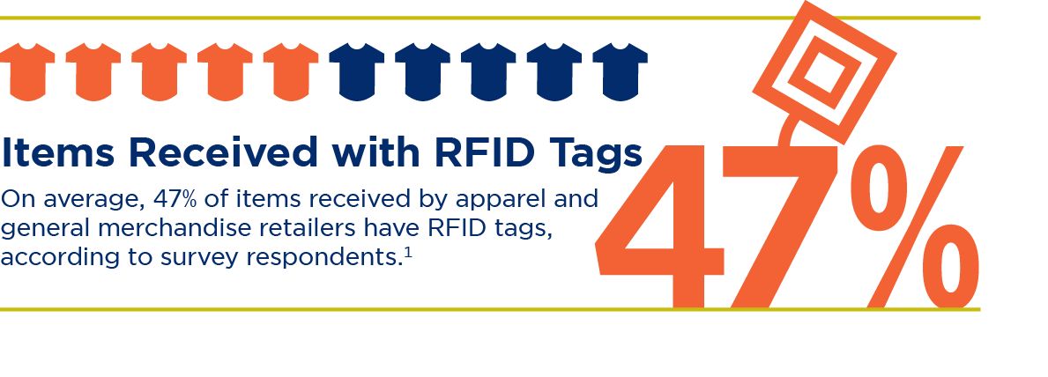
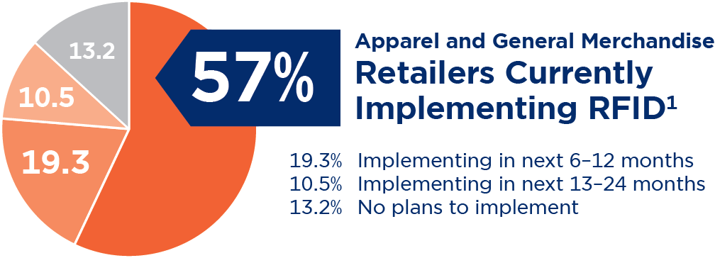
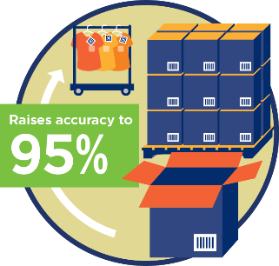
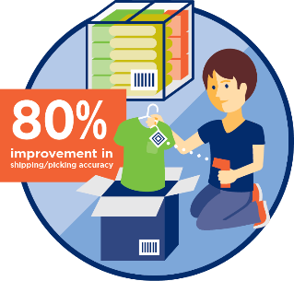
RFID is Gaining Traction!
Manufacturer Usage
Retailer Usage
Improves shipping/picking accuracy
Using item level tagging delivers an
80% improvement in shipping/picking
accuracy and improves receiving time by 90%.²
Raises inventory accuracy
Using item level tagging enables 95% accuracy
In the tracking of every piece of merchandise,
in every retail stock location (raising inventory
accuracy from an average of 63% to 95%).²
1. GS1 US Standards Usage Survey, 2014
2. Auburn University RFID Lab Studies, http://RFID.auburn.edu

Slide 14
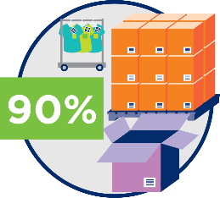
RFID Is Delivering Results For Manufacturers!
The Always-On, Always-Open Omni-Channel Shopping Experience
Raising receiving time and accuracy by 90%¹
Improving supplier compliance / Enabling electronic proof of delivery
Increasing margins
Enhancing loss prevention
Driving value - outbound audit at domestic point of receipt
Reducing operational costs
Reinforcing authenticity / anti-counterfeiting for luxury brands
Decreasing obsolete inventory write-downs
1. Auburn University RFID Lab Studies, http://RFID.auburn.edu
Notes:
Retailers around the globe are using it to increase inventory accuracy, drive point of sale improvements, decrease out-of-stocks, improve loss detection, enhance stock conversion reporting, increase full price sales, expedite the returns process and get more product into their customers’ hands than ever before.
For brand owners true inventory visibility starts at the factory, where item level RFID’s value is first achieved in the outbound audit process at the domestic point of receipt. In fact, benefits are derived through the entire supply chain—from electronic proof of delivery to improving receiving, pick/pack and shipping accuracy—helping brand owners improve supplier compliance, saving operational costs, reducing obsolete inventory write-downs and improving margins.

Slide 15
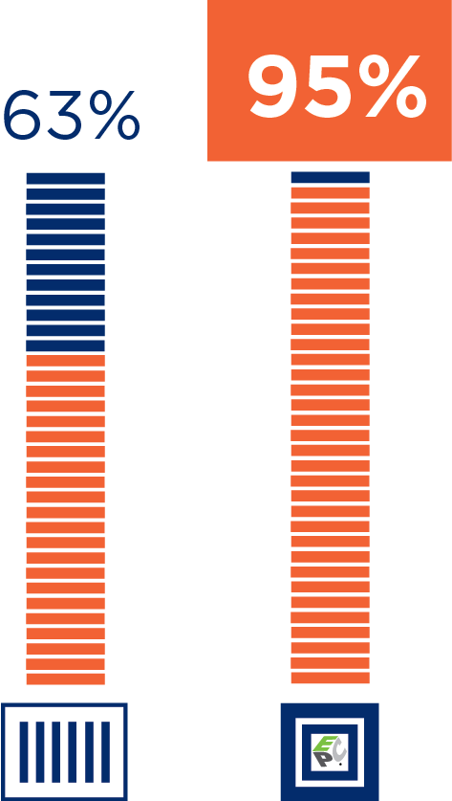
RFID Is Delivering Results For Retailers!
The Always-On, Always-Open Omni-Channel Shopping Experience
Reducing cycle
count time by 96%¹
Increasing full
price sales
Cutting out-of-stocks
at retail by up to 50%¹
Improving inventory
Labor productivity
by 96%¹
Driving POS improvements
Raising SKU inventory accuracy to 95%¹
1. Auburn University RFID Lab Studies, http://RFID.auburn.edu
Notes:
Retailers around the globe are using it to increase inventory accuracy, drive point of sale improvements, decrease out-of-stocks, improve loss detection, enhance stock conversion reporting, increase full price sales, expedite the returns process and get more product into their customers’ hands than ever before.
For brand owners true inventory visibility starts at the factory, where item level RFID’s value is first achieved in the outbound audit process at the domestic point of receipt. In fact, benefits are derived through the entire supply chain—from electronic proof of delivery to improving receiving, pick/pack and shipping accuracy—helping brand owners improve supplier compliance, saving operational costs, reducing obsolete inventory write-downs and improving margins.

Slide 16
Blockchain- what’s the buzz?
GS1 US Blockchain Discussion Group
The group is currently meeting to look at standards for Blockchain to provide visibility, transparency, and trust
Basic business processes in pilot organizations will need to be adapted before distributed ledgers will bring the expected value

Slide 17
The Role of Standards in Blockchain
Track & Trace, Anti-counterfeit
Order-to-cash processes
Electronic commerce
Business Applications
Standardized identifiers
Transaction data
Visibility event data
Master Data
Definitions of identifiers and other data to be shared
Data sharing rules
fits here
Oracle, IBM, Microsoft, Teradata, etc…
Amazon, Google, Bluemix, etc...
EDI Networks, VANs, data pools
Enterprise Access and User Layers
Blockchain is here
Database or other data sharing technology, Access and User Layers
Blockchain is a shared, secure, distributed ledger;
GS1 facilitates standards for data and some business applications

Slide 18
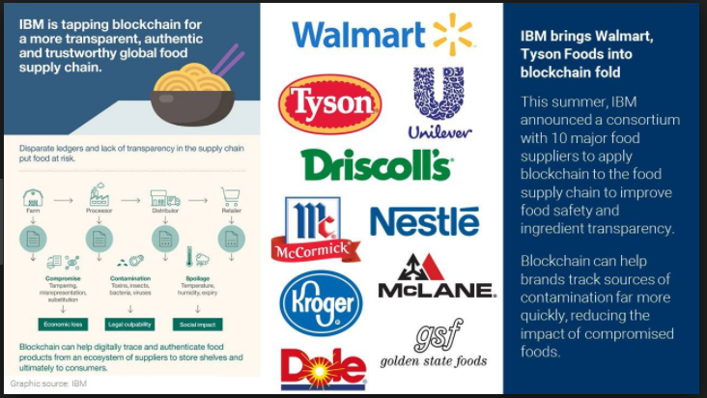
Pilots, Pilots, Pilots

Slide 19
Questions

Slide 20
Register Today for GS1 Connect 2019
June 19-21, 2019
Gaylord Rockies | Denver, CO
At GS1 Connect® 2019, supply chain partners will come together to learn how GS1 Standards can help meet today’s business challenges and unlock tomorrow’s opportunities.
The leading trading partner event, this is your chance to take your knowledge, your business, and your industry to new heights.
New this year: GS1 Connect 2019 features an Innovation Track and Startup Lab focused on the role of digital identity in a world disrupted by emerging technologies.
Learn more www.gs1connect.org

Slide 21
Contact Information
Susan Pichoff
Senior Director
Community Engagement, Apparel & General Merchandise
GS1 US
Princeton South Corporate Center
300 Charles Ewing Boulevard
Ewing, NJ 08628 USA
+1 609.647.6629
spichoff@gs1us.org

Slide 22
Legal Disclosure
GS1 US, Inc. is providing this presentation, as is, as a service to interested parties. GS1 US MAKES NO REPRESENTATIONS IN THIS REGARD AND DISCLAIMS ALL WARRANTIES, EITHER EXPRESS OR IMPLIED, INCLUDING BUT NOT LIMITED TO, ANY WARRANTY OF ACCURACY OR RELIABILITY OF ANY CONTENT, NONINFRINGEMENT, MERCHANTABILITY OR FITNESS FOR A PARTICULAR PURPOSE.
GS1 US shall not be liable for any consequential, special, indirect, incidental, liquidated, exemplary or punitive damages of any kind or nature whatsoever, or any lost income or profits, under any theory of liability, arising out of the use of this presentation or any content herein, even if advised of the possibility of such loss or damage or if such loss or damage could have been reasonably foreseen.
GS1 US employees are not representatives or agents of the U.S. FDA, and the content of this presentation has not been reviewed, approved or authorized by the U.S. FDA.

