Slide 1
Maximizing Your Office Influence
Eric Bloom
Executive Director
info@ITMLInstitute.org

Slide 2
Office influence is . . .
. . . the ability to move a person’s thinking, actions and/or decisions forward your business objectives.
Notes:
Ciera

Slide 3
Office Influence Survey Results Survey Answer Weighting
For each of the 76 attributes
1 = Not Important
2 = Somewhat Unimportant
3 = Somewhat Important
4 = Important
5 = Very Important
Notes:
Ciera

Slide 4
Office Influence Survey Results NEECOM Specific Survey Findings – TOP 20
Being Authentic 4.95
Trustworthiness 4.88
Transparency 4.80
Responsiveness 4.75
Active listening 4.75
Commitment 4.71
Experience 4.71
Having creativity 4.60
Team building 4.58
Follow-through 4.57
Accountability 4.52
Mentoring 4.50
Leading by example 4.48
Learned skills 4.48
Very Important 4.40
Vision 4.39
Motivation 4.39
Being respectful 4.38
Being proactive 4.35
Open mindedness 4.32
Notes:
Ciera

Slide 5
Office Influence Survey Results NEECOM Population vs. Overall Population
NEECOM
Overall Population
Being Authentic (14) 4.95
Trustworthiness 4.88
Transparency (15) 4.80
Responsiveness (22) 4.75
Active listening 4.75
Commitment 4.71
Experience 4.71
Having creativity (36) 4.60
Team building (18) 4.58
Follow-through 4.57
Trustworthiness 4.86
Active listening 4.76
Leading by example 4.62
Follow-through 4.61
Accountability 4.59
Commitment 4.59
Experience 4.57
Emotional intelligence 4.55
Asking purposeful questions 4.53
Vision 4.52
Notes:
Ciera

Slide 6
Office Influence Survey Results NEECOM Specific Findings – 11 to 20
Accountability (5) 4.52
Mentoring (17) 4.50
Leading by example (3) 4.48
Learned skills (27) 4.48
Loyalty (61) 4.40
Vision (10) 4.39
Motivation (11) 4.39
Being respectful (13) 4.38
Being proactive (12) 4.35
Open mindedness (20) 4.32
What does this mean for you?
Notes:
Ciera

Slide 7
Office Influence Survey Results NEECOM Specific Findings – Bottom 10
Industry and association activism (69) 3.33
Equipment (67) 3.29
Degrees (72) 3.19
Profession type (IT, Sales, Legal, etc.) (71) 3.10
Physical access (66) 3.00
Academic/media/political/industry contacts (74) 2.95
Location (75) 2.94
Certifications (73) 2.90
Job title (70) 2.81
Awards (76) 2.52
What does this mean for you?
Notes:
Ciera

Slide 8
Team Exercise
How much of your work time do you spend influencing others?
Activity % of Day

Slide 9
An average of 40% - 60% of their day

Slide 10
50%

Slide 11
On average 50% of people’s day is spent influencing others!
8 hour day X 50% = 4 hours
4 hours / 2 (because of influence training) = 2 hours
You save two hours a day!

Slide 12
What could you do with two hours a day?
Complete more tasks?
Mentor your team?

Slide 13
What could you do with two hours a day?

Slide 14
Influence Power Rating Key Concepts #1: Core Influence Characteristics
Your Core Influence Characteristics are five categories of personal traits that can enhance or detract from your ability to influence others. Understanding and enhancing these personally characteristics increases your overall influential effectiveness.

Slide 15
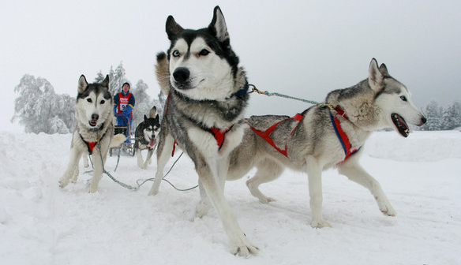
Personal Attributes
Notes:
These skill, as the name alludes, are related tot the interaction between people.
Active listening helps you listen to your boss and your spouse.
Having difficult conversations with members of your staff and family members of all generations

Slide 16
Soft Skills Types Personal Attributes: Internal
Confidence
Trustworthiness
Respectful and humble
Optimistic
Open mindedness
Influence
Vision
Motivation
Proactive
Opportunistic
Commitment
Flexibility
Determination
Accountability
Builds a professional brand of integrity, trust and respect
Creates your reputation as a change-agent
Helps you get the job done
Notes:
The standard cast of characters
When reviewing these lists, yes there are a few that I could easily move to one of the other categories.
Having effective meetings at the office and leading successful volunteer efforts that that help others.

Slide 17
Soft Skills Types Personal Attributes: External
Delegated authority
Friends, allies and advisories
Academic, media, political & industry contacts
Providing thought leadership
Being an information gateway
Industry and association activism
Follow-through
Showing you care
Using proper body language
Leading by example
Your social connections
Your social activities
Your actions
Notes:
The standard cast of characters
When reviewing these lists, yes there are a few that I could easily move to one of the other categories.
Having effective meetings at the office and leading successful volunteer efforts that that help others.

Slide 18
Professional
Stature
Notes:
These skill, as the name alludes, are related tot the interaction between people.
Active listening helps you listen to your boss and your spouse.
Having difficult conversations with members of your staff and family members of all generations

Slide 19
Soft Skills Types Personal Attributes
College degrees
Professional certifications
Profession type
Job title
Awards
Major accomplishments
Professional experience
Personal experience
Learned skills
Learned information
Your credentials
Your recognition
Your knowledge
Notes:
The standard cast of characters
When reviewing these lists, yes there are a few that I could easily move to one of the other categories.
Having effective meetings at the office and leading successful volunteer efforts that that help others.

Slide 20
Interpersonal Communication

Slide 21
Soft Skills Types Interpersonal Communication
Of great value in the office
Also, of great value at home
Notes:
These skill, as the name alludes, are related tot the interaction between people.

Slide 22
Soft Skills Types Interpersonal Communication
Emotional intelligence
Body language
Asking purposeful questions
Active listening
Conflict resolution
Difficult conversations
Public speaking
Business acumen
Facilitation
Written communication
Provides an understanding of others
Builds relationships and influence
Enhances fact finding and builds interpersonal rapport
Reduces stress, enhances productivity, facilitates teamwork and lowers attrition
Enhances your visibility, influence and upward mobility
Notes:
These skill, as the name alludes, are related tot the interaction between people.

Slide 23
Business Skills
Notes:
These skill, as the name alludes, are related tot the interaction between people.
Active listening helps you listen to your boss and your spouse.
Having difficult conversations with members of your staff and family members of all generations

Slide 24
Soft Skills Types Business Skills
Teambuilding
Running meeting
Building diversity
Vendor management
Consultative approach
Negotiation
Strategic planning
Goal setting
Time management
Interviewing/Hiring
Mentoring
Staff reviews
Helps build your team
Maximizes your personal productivity and effectiveness
Enhances one-on-one staff interaction
Builds loyalty in your team toward you
Notes:
Parent skills, story about first book

Slide 25
Resources
Notes:
These skill, as the name alludes, are related tot the interaction between people.
Active listening helps you listen to your boss and your spouse.
Having difficult conversations with members of your staff and family members of all generations

Slide 26
Soft Skills Types Resources
Money
Equipment
Software
Location
Physical access
Documentation
Business process
Intellectual Property
Relevant Information
Organizational access
Personal connections
Ability to provide needed resources
Ability to provide need information and expertise
Ability to provide needed business connections
Notes:
Parent skills, story about first book

Slide 27
Influence Power Rating Key Concepts #2: Situational Influence
All influence is situational. Understanding your relative level of knowledge and control as compared to others is key in assessing your ability to influence them.

Slide 28
Influence Power Rating Situational Influence Examples
A Project Manager has more influence power over her team than over her stakeholders
A brain surgeon who has no knowledge of football has a high level of influence over his patients, but has very little influence discussing the NFL’s best quarterback with his friends

Slide 29
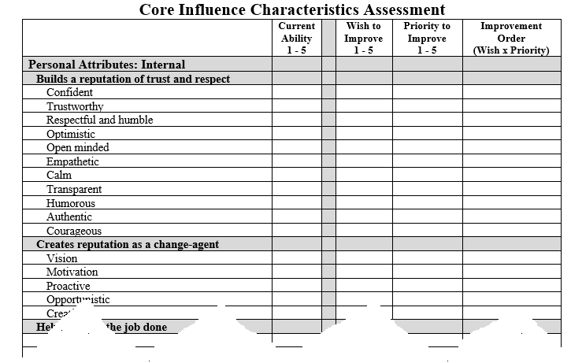
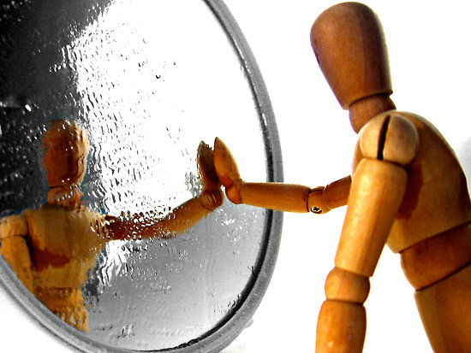
Influence Power Rating Worksheet
Core Influence Characteristics
Situational Influence
(
)
+
+
+
+
Personal
Attributes
Professional
Stature
Interpersonal
Skills
Business
Skills
Situational
Knowledge
Situational
Audience
Resources
X
X
=
IPR
1 - 5 1 – 5 1 – 5 1 – 5 1 – 5 0 – 2 0 - 2

Slide 30
Thank You
Eric Bloom
Executive Director
IT Management and Leadership Institute
eric@ITMLInstitute.org
Twitter: @EricPBloom

