Slide 1

Welcome
10/25/2018
Westborough, MA

Slide 2
Yes, Retailers and Distributors Can Survive and Thrive by Unifying Commerce and Supply Chain
Retailers and distributors are finding success by moving beyond even omni-channel thinking to truly unified commerce
Start with an intense focus on the end-to-end customer experience
Full integration across both internal applications and your network of trading partners
Connecting people, process and technology across commerce and supply chain operations

Slide 3
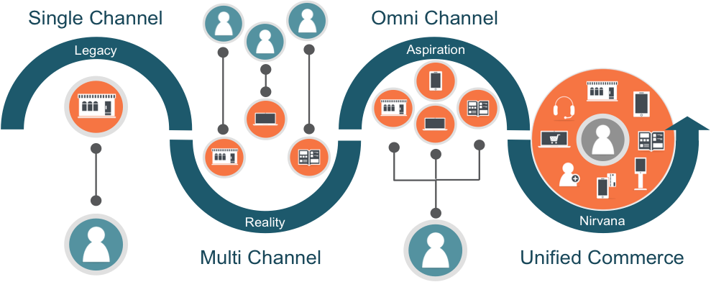
Omni-Channel to Unified Commerce

Slide 4
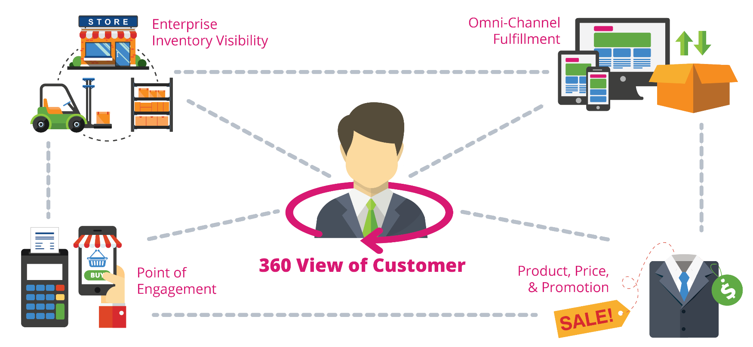
Unified Commerce

Slide 5
Foundational Principles to Unified Commerce
Best Practices to Convert Digital to Physical
Omni-Channel Enablement | Best Practices
Enterprise Inventory Visibility | Real-Time Visibility to all Inventory Order/Reserve online Capabilities
Buy Online/Pick-Up In Store | Accurate in-store inventory visibility (>98%) Short fulfillment times (< 30 Minutes) Customer Notification (<2 Hours)
Ship-From-Store | Same Day Pick and Pack (capacity analysis) Efficient Algorithms to Manage Fulfillment
Ship-To-Store | Easy process for store Receiving 3-Day SLA for ship-to-store orders
Endless Aisle | Structure staff training/testing on Tools Ease of Use (Same POS Interface)
Enterprise Wide Inventory Visibility
Order Orchestration
Omni-Channel Enablement
Customer Experience

Slide 6
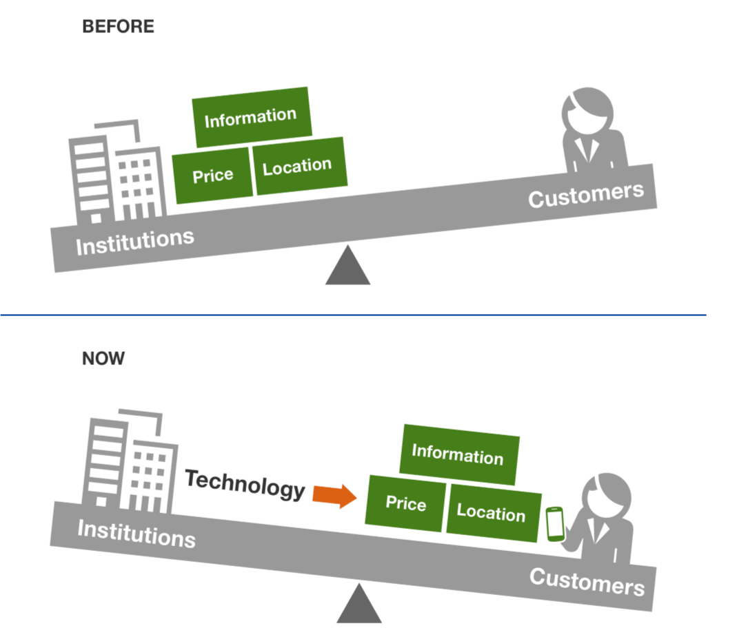
The Age of Digital Transformation
Your customers are empowered more than ever:
Organizations used to own the experience
Technology in customers hands has given them more choice and control
Your customer now demands experiences along with their buying journey

Slide 7
The Age of Digital Transformation
The physical store is rising in importance because of digital. The ability to buy online and pick up in the store has retailers using the stores as fulfillment centers.
After all, 94% of total retail sales are still generated at brick and mortar stores, according to data from market research firm eMarketer.
In the end, online shopping fosters a customer’s purchasing habits while brick and mortar supports a customer’s purchasing decision.
79.7% of all US shoppers prefer going to a store “because I can touch and feel the product”
73.5% prefer to shop at a store rather than online because “I am more confident that I am buying the right thing”
Only 10-15% of U.S. adults make online purchases at least once a week, according to the Pew Research Center.

Slide 8

SETTING THE CONTEXT

Slide 9
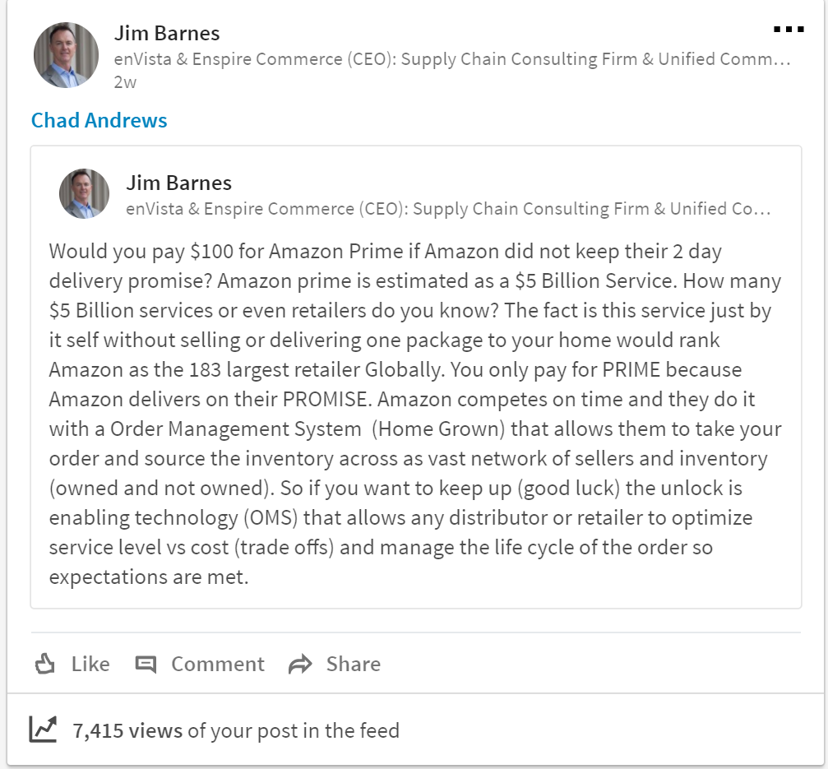

Slide 10
Is this really your answer to beating Amazon?
1

Slide 11
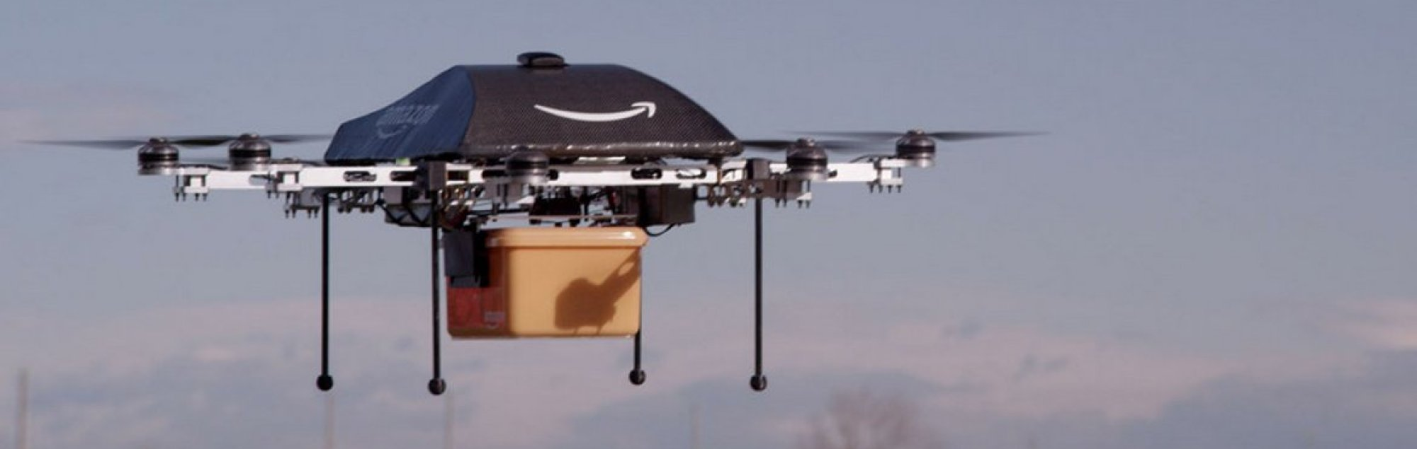
Is this really what you are focused on?

Slide 12
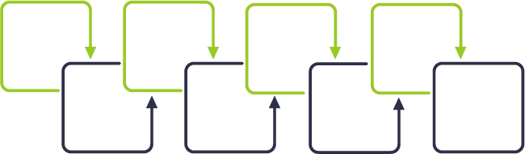
Order Life Cycle Management
1
3
5
7
Item
Customer
Payment
Shipment/
Carrier
2
4
6
8
Inventory
Fulfillment
Return
Order

Slide 13
Brian’s Purchasing Process

Slide 14
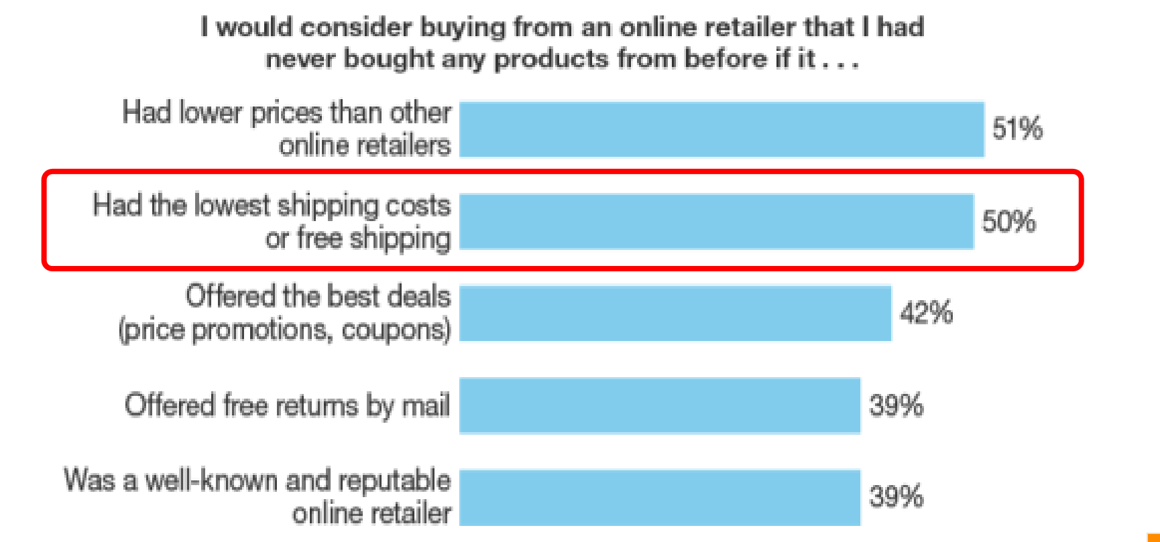
Omni-Channel Enablement
Source: Forrester Research

Slide 15

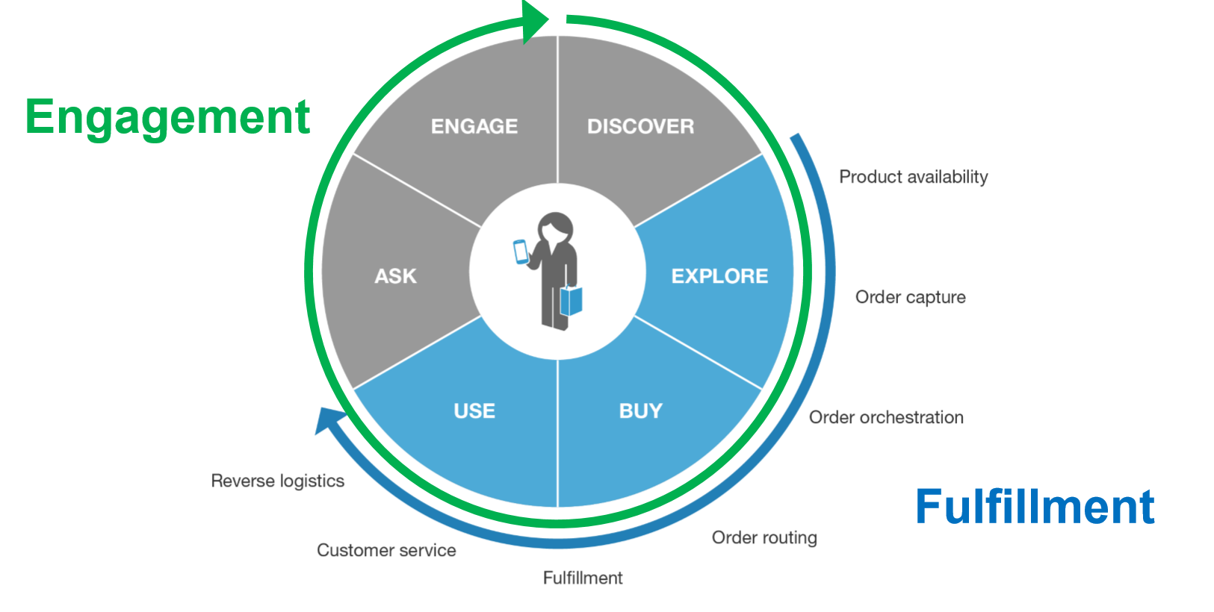
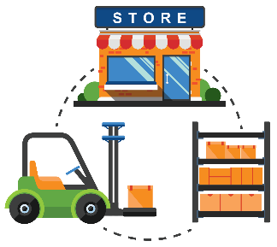

Slide 16
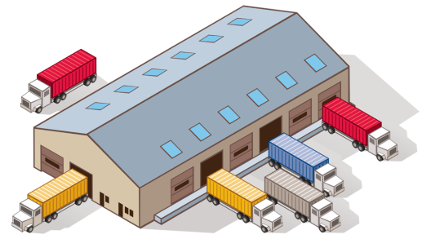
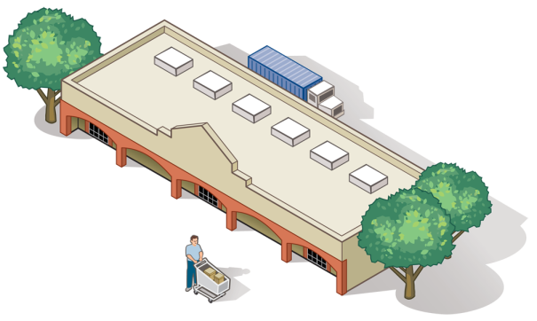
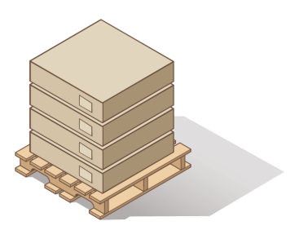
Multi-Enterprise Inventory Visibility
Enterprise Inventory Visibility
Vendor
Inventory
DC
Inventory
3PL
Inventory
Retail
Inventory

Slide 17
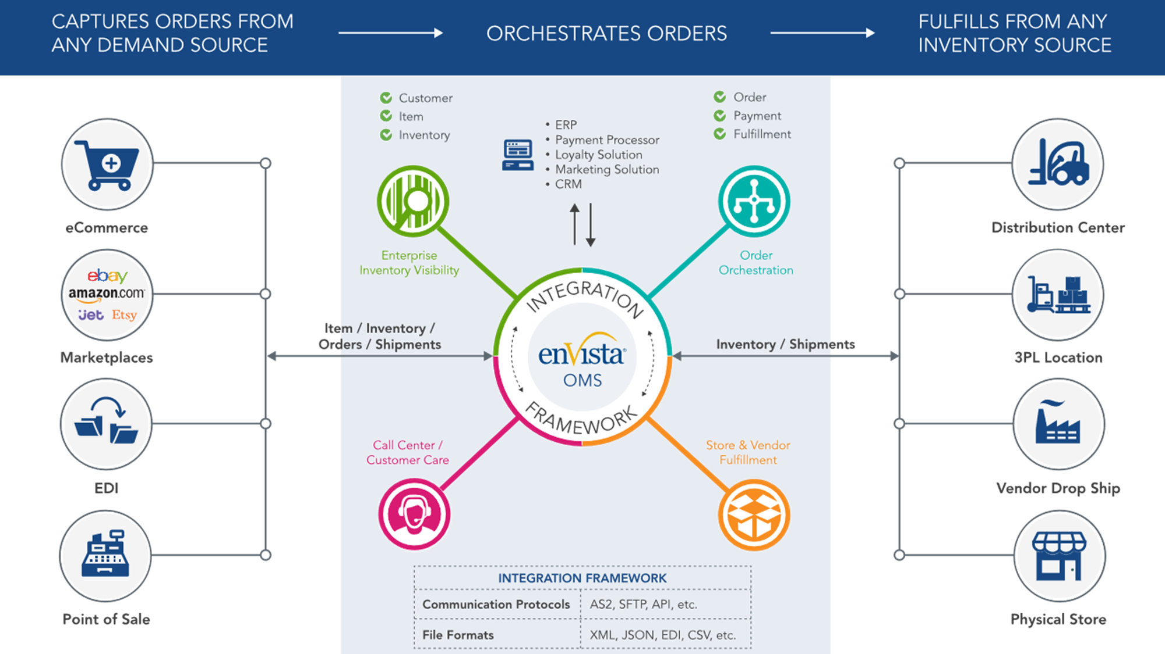

Slide 18
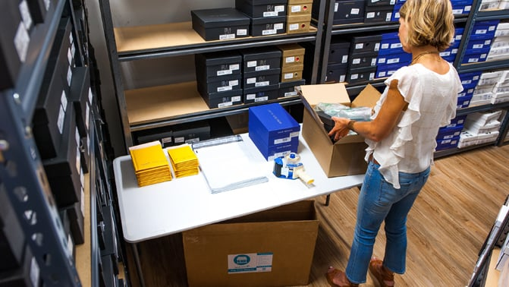
Unified Commerce Investments
Many companies still need to invest a robust OMS to optimize omnichannel
Additional investments are needed to optimize stores:
  Better tools for pick and pack
  Better tools for ship-from-store operations
Many companies still need to invest in a TMS to manage inbound transportation and the life cycle of a Purchase Order

Slide 19
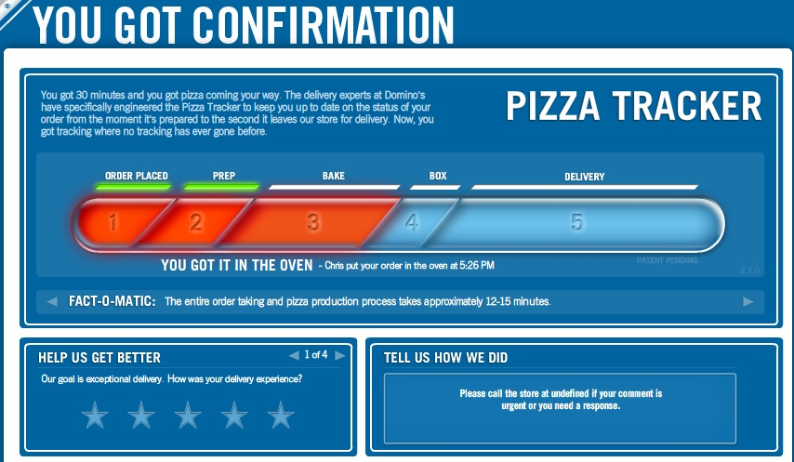
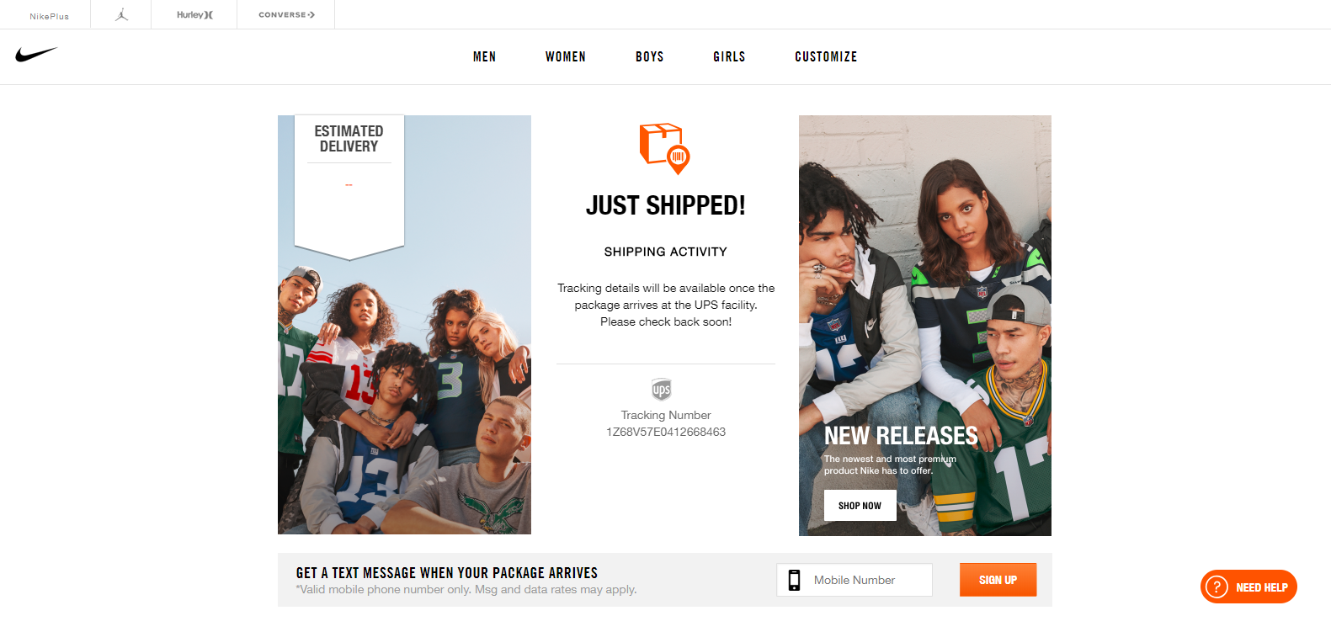
Invest in the Customer Experience

Slide 20
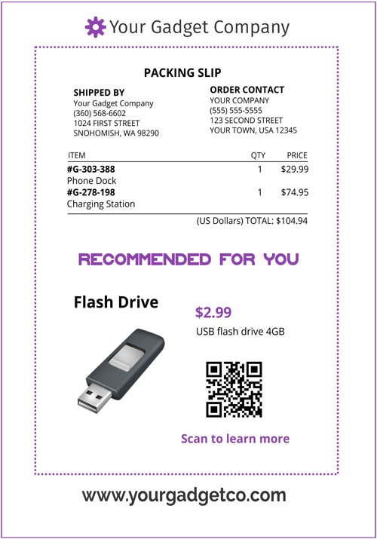
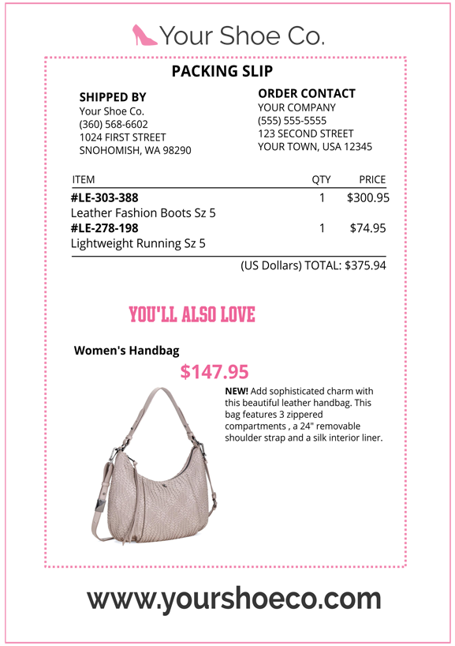
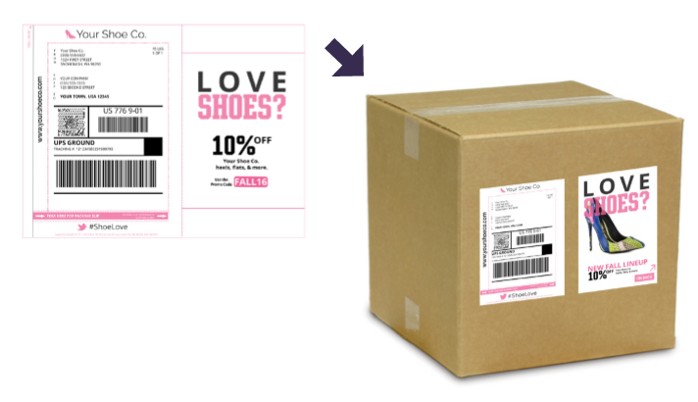
Invest in the Customer Experience

Slide 21

What is Your Role?
The Goal
Seamless & Consistent Customer Experience From Start to Finish… and you are NEVER Finished

Slide 22

CUSTOMER FIRST! Bust Silos!!!

Slide 23
Customer Engagement Life Cycle
Technology
Process
People
Bust Silos; Customer has to be first
Processes built with customer as the center
OMS is central to unified commerce

Slide 24
DIGITAL IS EVERYTHING,
BUT NOT EVERYTHING IS DIGITAL
COMMERCE IS ABOUT EXPERIENCE, NOT BRAND ACCESS. RETAIL IS THRIVING FOR THOSE THAT EMBRACE UNIFIED COMMERCE (PROCESS, PEOPLE, AND TECHNOLOGY)
CUSTOMER EXPERIENCE DOES NOT STOP AT CHECKOUT. POST CHECKOUT IS WHERE YOU WILL DIFFERENTIATE YOURSELF
UNIFIED COMMERCE PLATFORMS ARE THE CORNERSTONE TO THRIVE IN THIS GLOBAL ECONOMY & NOT POINT APPLICATION SOLUTIONS
IF YOU REMEMBER
NOTHING ELSE

Slide 25
Questions?

Slide 26
For More Information:
candrews@envistacorp.com
www.envistacorp.com

