Slide 1

Best Practices in Partner Automation

Slide 2
Agenda
Introduction
Supply Side Automation
Demand Side Automation
What is “Partner Automation”?
Partner Automation Best Practices
About TIE Kinetix
Q&A

Slide 3

Quotes
“Innovation distinguishes between a leader and a follower”
~ Steve Jobs
“But we’ve always done it that way!”
~ Company #9999 on the Business 10,000 List

Slide 4

If We Say “Partner Automation”…
Do you think:
Supply Chain?
EDI?
Product information?
…
And what about generating DEMAND for Products?

Slide 5


Factors that Increase Complexity in Automation
Poor Partner Engagement
High Competition for Mindshare
Limited implementation of tools and tactics
Poor opportunity management
Too Much Work to Execute Programs
No capability to sell or deliver services online
Lack of Visibility & Intelligence
Fragmented Strategy & Enablement
Lack of Control Over Content, Data & Brand
Slow Adoption
Inability to forecast demand
Limited Dedicated Resources
No visibility into key processes
ECommerce complexity
Limited Visibility into the Customer Experience
Limited Visibility into the Partner Experience
No Clear Vision How to Collect Data
Fragmented Systems Promote Data Silos
Unclear how to Extract Business Intel Out of Data
Slow Logistics & Expensive Fulfillment
Manual Order Processing, Billing, Invoicing, etc.
Lack of Integration Between Core Business Systems
Needs to be simple
Limited Capabilities and Compliance

Slide 6
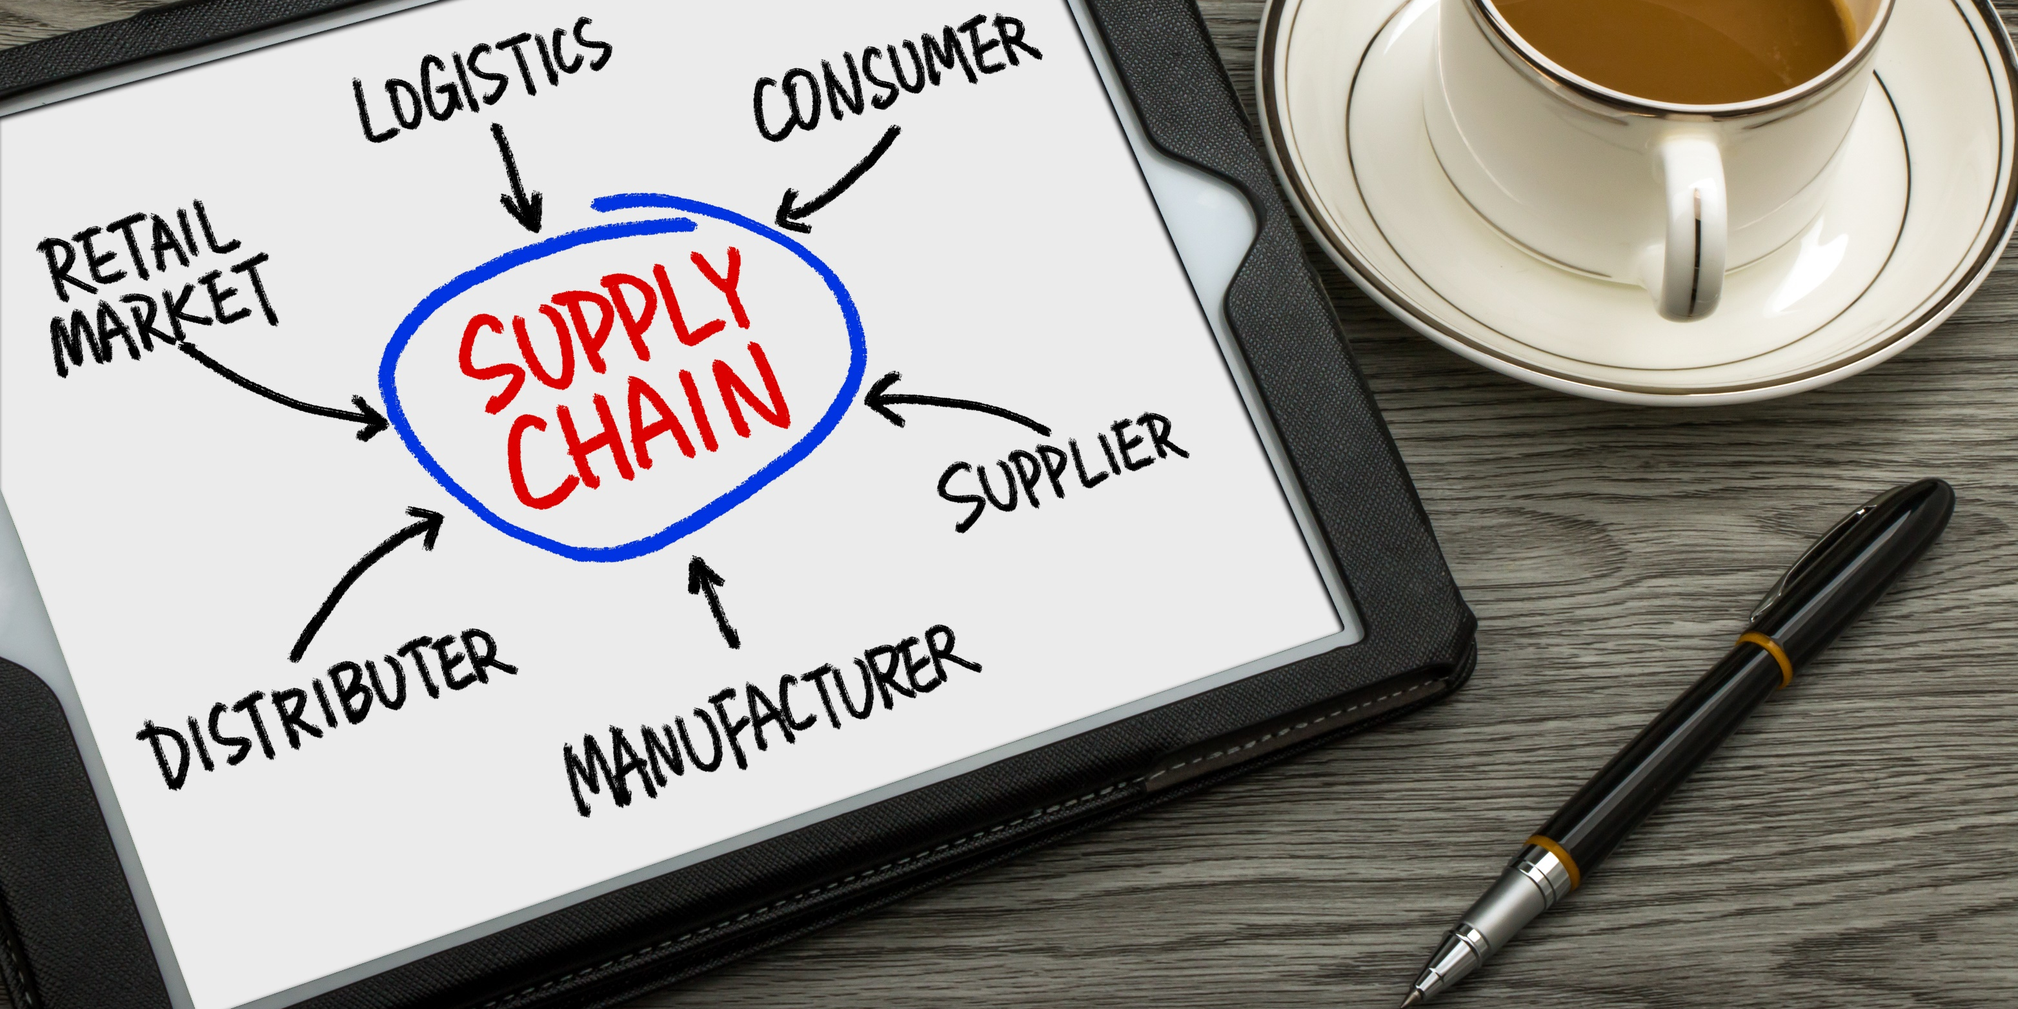
Supply Side Automation

Slide 7

Inventory of Your Capabilities
“Doing EDI”? If not or having issues, please come us.
With your Customers? They usually mandated you.
With your Vendors? Carriers? Banks?
Do you have an on-site translator and staff?
  Being updated or discontinued?
  Throughput capability (will it grow with you?)
  Will your staff retire soon or worse….quit?
Are you using a Service Provider’s Managed/Cloud Services?
  Features (Real-time? API integration?)
  Capabilities and Uptime (how is that verified & reported to you?)
  Integration & Mapping (Custom or Canonical, TP-Packs?)
  Technical Support (US-based?); SLA included?
  Where is your data stored & backed up? (US? Cloud? Other?)

Slide 8
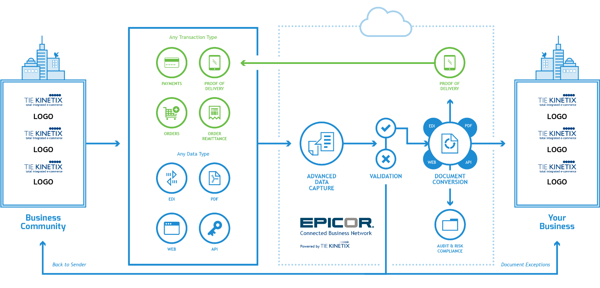
Beyond EDI
YOUR
PARTNER
YOU

Slide 9


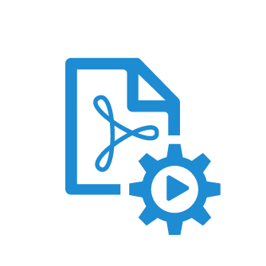

Supply Side Automation Best Practices
Integration of EDI
Not just for enabling Customers
Find other areas of automation
Business Document Validation
It’s not just for Retailers anymore!!
Pre-validate prior to transmission to your Partner
Better Chargeback avoidance vs. Retailer-checking
Extended File Type Integration
PDFs, XML, Email attachments, etc.
Accept into EDI or bypass the translator!
Web-Portal Automation
Built to YOUR specifications
Inbound Txns, Outbound Txns or Both
Use for small Customers or small Vendors
Use for non-standardized Business Docs
Can CO-EXIST with your established EDI program

Slide 10



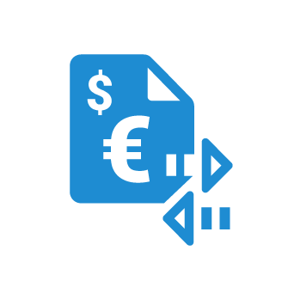

Supply Side Automation Best Practices
System Connectors
Using pre-tested, pre-formatted integration
Prevalent with Managed Services/SaaS/Cloud
Your provider should have relationships and not be custom programming
Dashboards, Archiving, Reporting, Alerting
Utilize a modern, fast, flexible tool
Is your provider adding features often?
Your tools should LINK DOCUMENTS (matching)
Trading Partner Connections
80/20 rule still status quo for most
Choose top-tier provider for more access
Automate more of your trading community
Use Partner Automation tools (Channel, Vendor, Customer, Others)
E-Invoicing (standardized)
More demand from Customers
More demand from Governments
Make sure your provider has experience and certifications (PEPPOL in EU, etc.)

Slide 11

Demand Side Automation

Slide 12
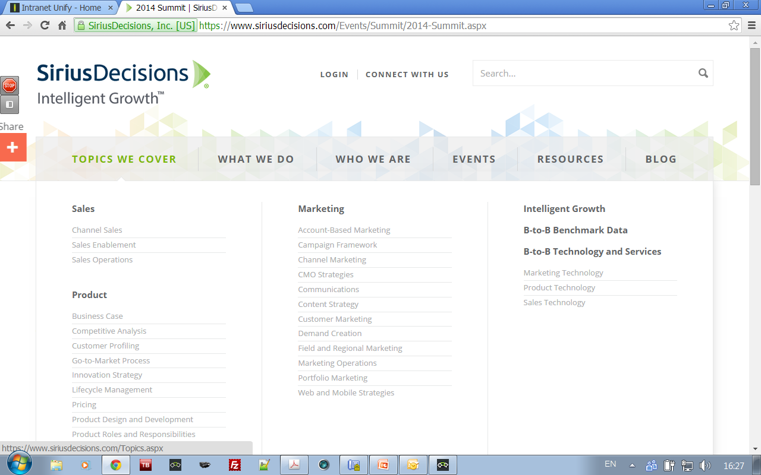
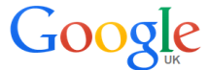
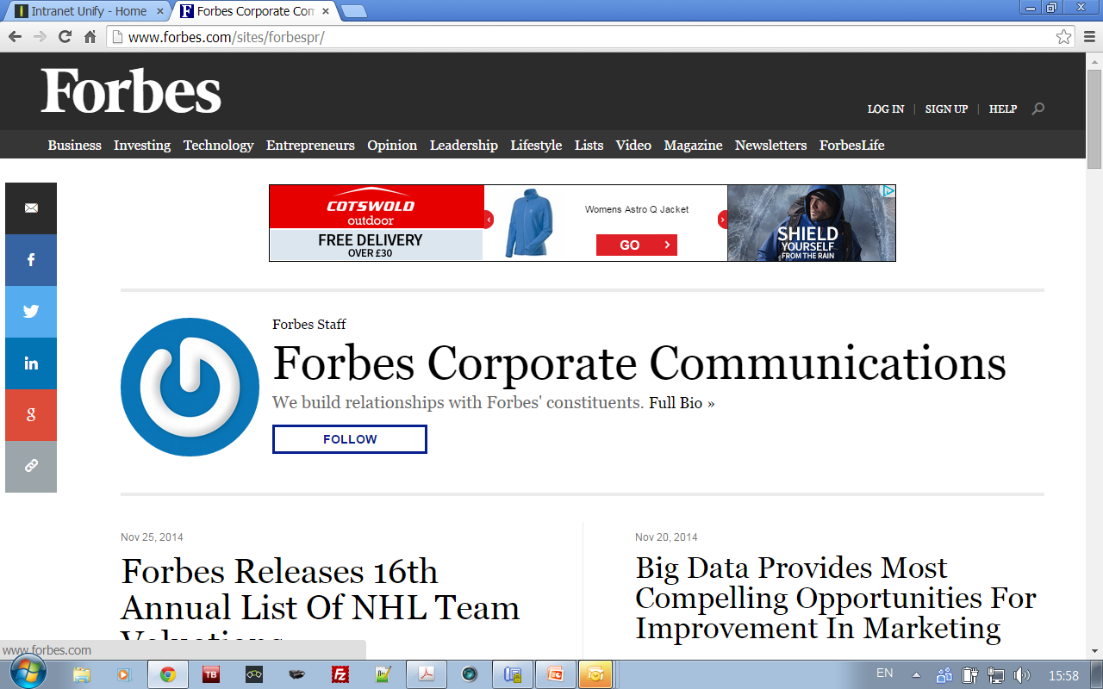
Change in Consumer Journey
67% of the buyer’s journey is now done digitally. “Buyers are more knowledgeable and are engaging later with sales…”
57% That's how far the average buyer is through the purchase decision before engaging a supplier sales rep.
60% All customers are 60% through the sales process before asking for more information.
1999
Online
In Store
Research Journey
Purchase
2017
Online
In Store

Slide 13
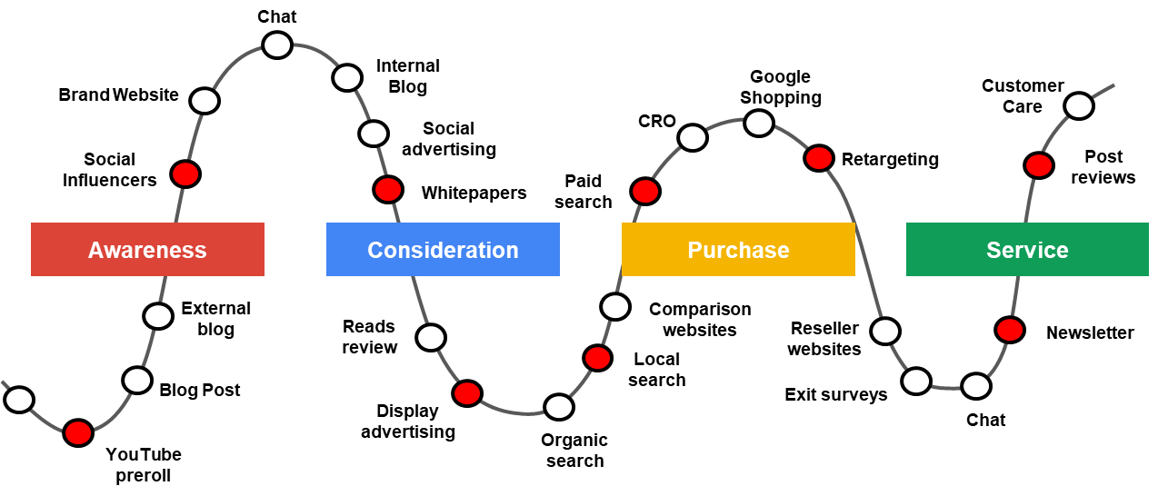
Change in Consumer Journey

Slide 14

Marketers Will Invest In Technology Even More
Global B2B marketers spend 22% of their marketing budget on technology
66% are planning to increase their technology spend in the upcoming year
  Programs
  and
  Media
  Technology
  Other
  Personnel
  Market research
  and data services
  Source: Forrester Data Global Business Technographics® Marketing Survey, 2017
  Making The Right Choices For Your L2RM Tech Stack Tools And Technology: The Lead-To-Revenue Playbook. By Lori Wizdo with Caroline Robertson, Steven Casey, Alexander Bullock, and Kara Hartig. February 21, 2018 | Updated: March 13, 2018

Slide 15

Challenges with Disconnected Systems
Fragmented data / Technology silos
Extended wait time
Human interaction = Errors
No visibility on channel funnel results
Partners don’t have resources
Unclear ROI
Bad customer experience
No journey personalization
Unprotected data across all channels
Many marketing tools were built as point solutions

Slide 16

Reduce Complexity & Improve Partner Agility
Supplier
or Manufacturer
Retailers
End Consumers
Content, Campaigns, Data,
Documents, Leads, Orders, Invoices
Content, Campaigns, Data,
Documents, Leads, Orders, Invoices
Data, Documents, Leads,
Orders, Invoices
Data, Documents, Leads,
Orders, Invoices

Slide 17

Partner Automation

Slide 18

Partner Automation
Supply Side
A profitable value chain is a set of interrelated activities a company uses to create a competitive advantage.
Collaboration: Work with, through, to and from your partner ecosystem
More Demand + More Orders Processed = More Revenue
Demand Side
Value Chain

Slide 19
Supply Side – Partner Profiles
LARGE
Pro-Active
Enterprise IT
Large organization
In-house IT and Integration solutions
ERP
Own resources
(time, money, skills)
MEDIUM
Reactive
Professional IT
Mid size organization
Good knowledge / structure
Good insight market trends
Knowledgeable IT
Financial system
Limited resources (time, money, skills)
SMALL
Wait for it
No IT
Small organizations
Little to no IT knowledge and structure
Book keeping software / manual
No resources (time, money, skills)
Large suppliers
20%
35%
45%
Number of suppliers

Slide 20
Demand Side – Partner Profiles
INDEPENDANT
Corporate Marketer
Large single-tier partner or distributor
Carries many global brands
In-house marketing automation
Sophisticated marketing practitioner
DIY
(Do it yourself)
Power Marketer
Large or midsized single tier partner
Knows its target market well
Competent market strategist
DIFM
(Do it for me)
Neophyte
Large or midsized single tier partner
Knows its target market
Already executing some marketing activities such as events or email campaigns
OBO
(Do it on behalf of)
Luddite
Small or midsized single-tier partner
Relies heavily on sales, business development, and relationships to grow the business
Introduction
SIZE of resellers
5%
20%
35%
40%
NUMBER of resellers

Slide 21
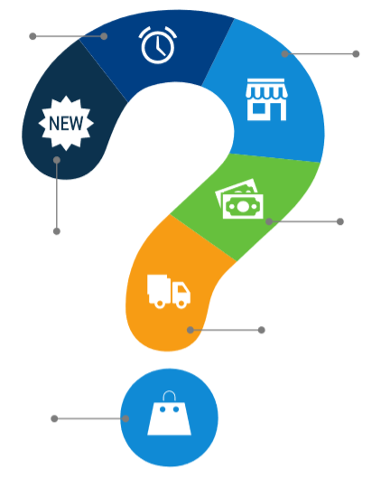
Listen to All Your Partners
How easy is it to sell my products?
What are you seeing in your backyard?
Are you on track to hit our agreed upon sales goals?
Are you running the latest marketing campaigns?
How easy is it to deliver my product?
How happy are you and your customers with my product?

Slide 22

Seamless Integrate All Partner Processes
Generate Demand
Ease of doing business
Amplify brand activities for your entire partner community
Improved quality and quantity of leads
Empower partners to sell more
Reduce Work
Support the entire buyers journey from enablement, transaction and fulfillment
Connect, train, test, certify
Automated distribution of marketing content, campaigns and tactics
Extended capabilities for online or offline ordering, billing and shipping processes
Extend Capabilities
Faster time to market (velocity)
Improved access, convenience and service through mobile
Seamlessly integrate and connect to any business system
Improve Intelligence
Measure and improve partner effectiveness
Understand the buyers journey and content relevance
Early identification of negative partner or consumer experiences
Audit capabilities for the entire logistics process

Slide 23

What’s In It For You?
The Power to Generate More Revenue by Automating Partners

Slide 24
3 Take-Aways
Automate both your supply and demand side of your business
  Save time
  Drive Your Company’s revenue
INTEGRATE the two sides of your business!
Engage with an expert provider for consultation
1
2
3

Slide 25

About TIE Kinetix

Slide 26
Consistently Driving Partner Automation Globally
About TIE Kinetix
High Customer Satisfaction (+3,000)
& Employee Retention (160)
Product Vision and Agility for
Long Term Customer Success
We Facilitate Over 3 Billion Orders, Invoices and Content Requests per Year.
30+ Years in Business
“Long-Term Viability Is Strong”
Sirius Decisions
Research: SiriusView Channel Management &
Marketing Platforms, 2015
“A Strong Performer”
Forrester
Research: Through-Channel Marketing
Automation Platforms, Q3 2015
“Effective Vision of the Nexus of Forces”
Gartner Research
Research: Magic Quadrant for Integration Brokerage, 2014

Slide 27
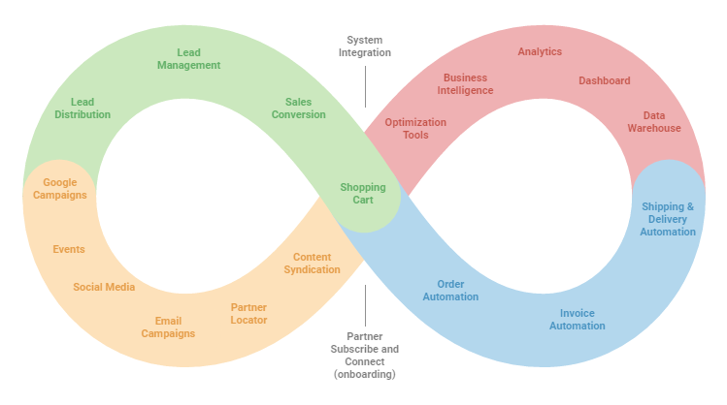

What do we do for our customers?
Automate and Accelerate Partner Business.
Lead and Sales Conversion
Analytics & Optimization
Brand Control and Demand Generation
System and Supply Chain Integration

Slide 28

Q&A

Slide 29
Shawn Lisbon
VP of Business Development
Shawn.Lisbon@tiekinetix.com
Anthony D’Angelo
VP of Business Development
Anthony.Dangelo@tiekinetix.com

