Slide 2
NETWORK LIKE A NINJA CONNECT WITH CHARISMA AND POLISH YOUR PEOPLE SKILLS

Slide 5
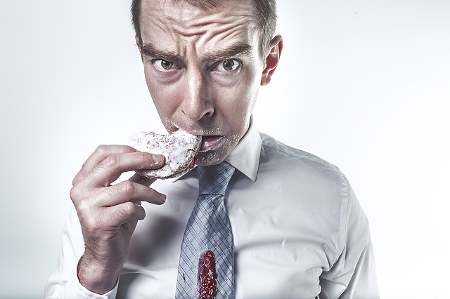

Slide 6
NETWORKING Creating mutually beneficial, business relationships – before you need them.

Slide 7
9 STEPS TO BECOMING A NETWORKING NINJA

Slide 8
No. 1 Don’t go in cold
Do your homework
Research people you want to meet
Scan the room
Select your targets

Slide 9
No. 2 BE A BIG DEAL
Allow your confidence to show
Smile and nod toward everyone

Slide 10
No. 3 vips & speakers first
Have a solid statement at the ready
Approach speakers before there’s a line after their talk

Slide 11
No. 4 Lead with your hand
A clear sign of self-assurance

Slide 12
No. 5 Breakfast time!
Now you know the lay of the land
and where to sit

Slide 13
No. 6 Spot the lone wolves
Approach singles
Approach groups
Avoid parties of two

Slide 14
No. 7 Get introduced
An implied endorsement
Makes you more memorable

Slide 15
No. 8 craft an intriguing introduction
You’re not your job title
"I help "X" do "Y" so they can "Z".

Slide 16
No. 9 ending conversations
First impressions / Lasting impressions
Business Cards

Slide 18
charisma
The ability to attract, charm, and influence the people around you.

Slide 19
6 characteristics of charisma
1. Self-esteem
2. Exuberance
3. Optimism

Slide 20
6 characteristics of charisma
4. Smile
5. Body Language / Non-Verbals
6. Sound + Tone of Voice

Slide 21
6 WAYS TO BECOME CHARISMATIC + MAGNETIC

Slide 22
No. 1 empathy
The ability to see things from another person’s perspective and to understand how that person is feeling.

Slide 23
No. 2 Listening
To truly hear what someone is trying to communicate to you, both verbally and nonverbally.

Slide 24
No. 3 eye contact
We intuitively feel that when someone’s gaze shifts away, so has their attention.

Slide 25
No. 4 enthusiasm
Uplift another person by praising their actions or ideas.

Slide 26
No. 5 Confidence
Feeling self-assured, while not worrying about what other people think.

Slide 27
No. 6 voice + tone
When you are present , you’re able to better understand.
Only then can your words be sensitive and appropriate.

Slide 28
POLISHING YOUR PEOPLE SKILLS

Slide 29
PROFESSIONAL PRESENCE
A BLEND OF BUSINESS EXPERTISE, MANNERS, ETIQUETTE, INTERPERSONAL + SOFT SKILLS THAT REPRESENT YOUR OVERALL COMPETENCE

Slide 30
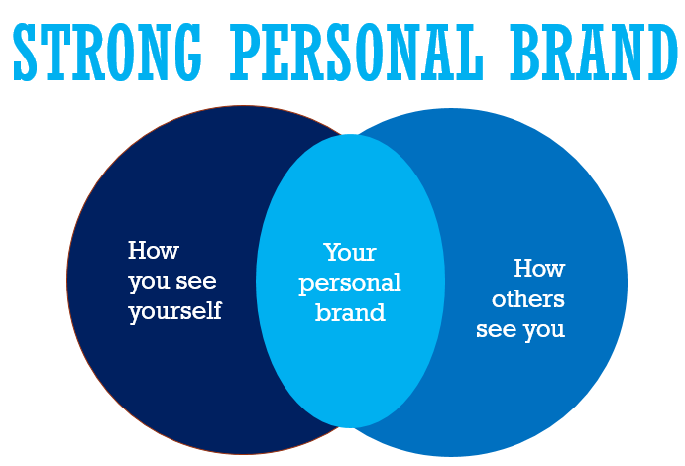

Slide 31
6 POWERS OF PROFESSIONAL PRESENCE

Slide 32
CONNECT

Slide 33
MIMESIS

Slide 34
MAKE people FEEL SPECIAL

Slide 35
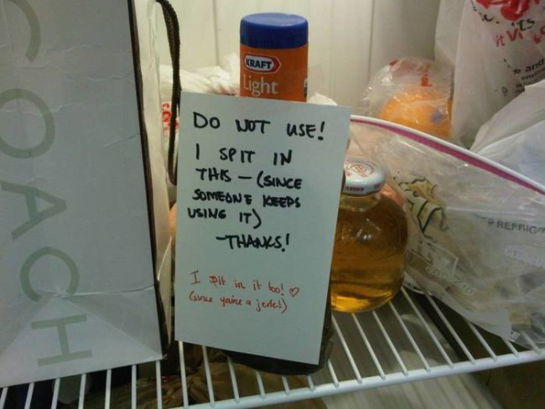
WORKPLACE MANNERS

Slide 36
conference MANNERS

Slide 37
blogging + PUBLIC SPEAKING

