Slide 1
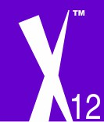
EDI and Evolution
Jim Taylor, X12 Board Chair
May 16, 2018

Slide 2
disclaimer
This presentation is for informational purposes only
The content is point-in-time information, subject to revision
Notes:
2

Slide 3
Outline
X12 EDI Standards
Historic Participation
Evolving Technologies
Evolving Business Needs
Intersection of Evolving Needs & Technology
Wrap-up
Notes:
3

Slide 4
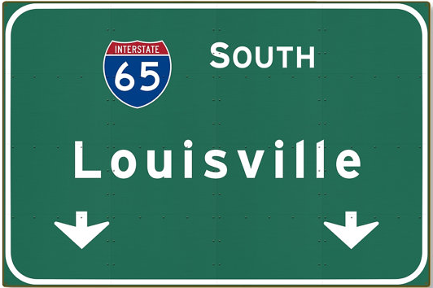
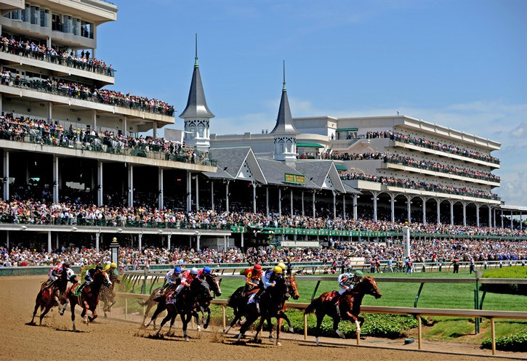
But First…
Notes:
4

Slide 5
X12 EDI Standards
Millions of entities around the world benefit from the use of X12 standards
Trading partners don’t always realize they use X12
Many partner-to-partner “standards” are developed based on X12 Intellectual Property
Better alignment is needed: the value of using X12 IP with the cost to equitably evolve
The key is evolving X12 to better meet the needs of its members and related consumers

Slide 6
Historic participation
Like-minded trading partners and software/service providers collaborate to build consensus on the content and syntax requirements for B2B data exchange
Implementing technology to produce, interpret, consume and other wise translate EDI transactions was capital-intensive

Slide 7
Evolving technologies
New technologies present X12 with interesting opportunities to expand it’s highly-structured transaction offerings
More flexible offerings benefit from consistency, efficiency, and improved communication:
XML
JSON
Others?

Slide 8
Evolving business needs
Barriers to obtaining and implementing technology are much smaller:
More competing vendors
Cloud-based sourcing models
Individual transactions, sent in real-time transactional
Smaller, more flexible messages

Slide 9
intersection of evolving needs & Tech.
A lot can be derived from hierarchical, highly-structured messages
It’s about the metadata
New technologies allow us to meet, intersect, if you will with the business needs
A new approach helps:
Standardized vocabulary
New structures or even unstructured messages

Slide 10
A practical Look
Remember this sign?
Standard Letters
Standard Backing
Standard Information
Standard Direction
Standard Route
Clear information/Data - when read

Slide 11
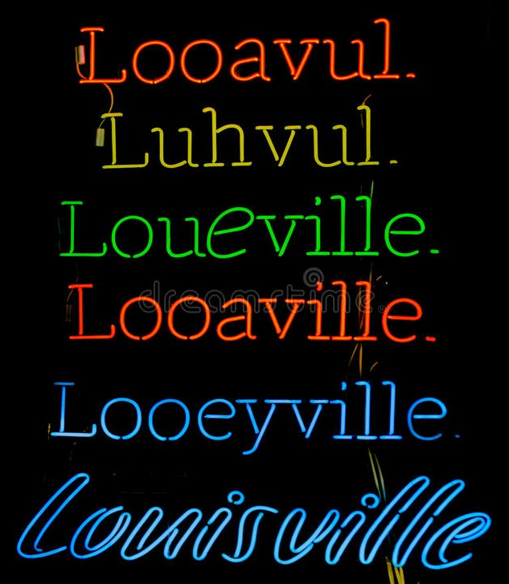
A practical Look
Have you ever see this?
When said, no standard
Which is considered correct?

Slide 12
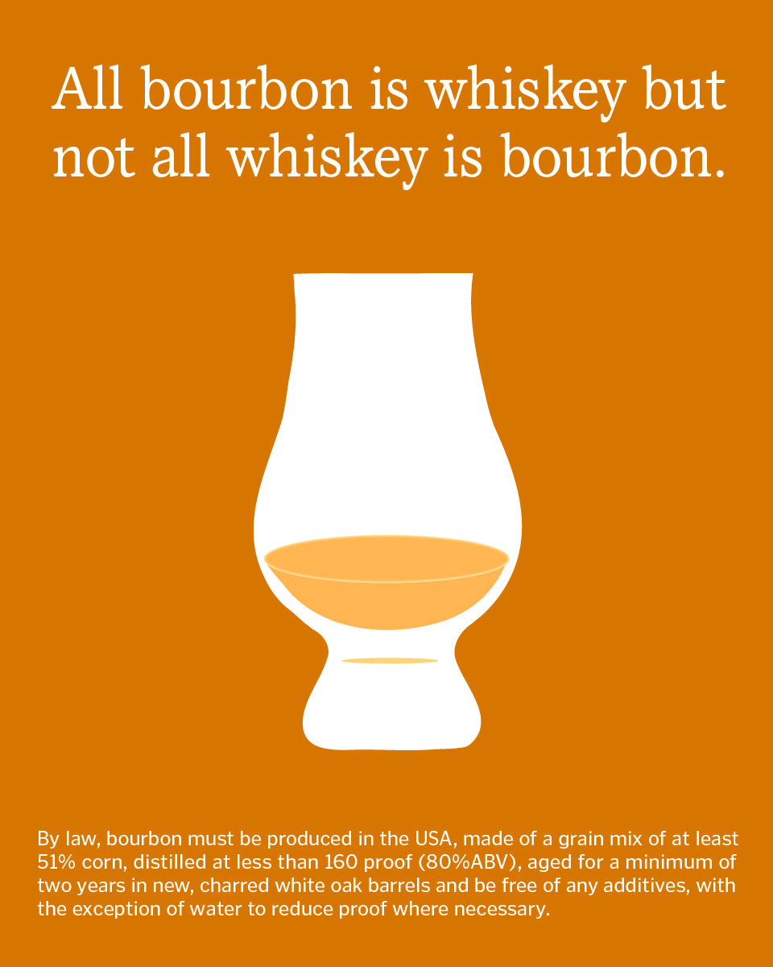
A practical Look
Bourbon or Whiskey?

Slide 13
Wrap-up
X12 has an extensive, tried-and-true vocabulary in its metadata
X12’s metadata has evolved over 4 decades of effective and and comprehensive use, enabling trading partners to exchange enormous amounts of information points in order to conduct business
X12 is producing derivative offerings to meet trading partners evolving needs
XML and JSON messages
Using X12’s standardized vocabulary, it’s metadata

Slide 14
Thank you
If you have feedback or questions regarding the information presented, post them at www.x12.org/forms/feedback
More information about X12 is at www.x12.org
Stay informed by following X12 on Social Media Twitter: @ASCX12 LinkedIn: #X12
Notes:
14
14

