Slide 1
Extending Your Integration Strategy
Barry Sponsler
Sr. Solutions Architect

Slide 2
Market Dynamics Challenging Companies
Ecosystem
Enablement
Modernizing IT
Systems
Improve
Service Levels
Flexibility for front-end applications and agility for back end systems to ensure low friction with customers
Shift to the cloud by adopting SaaS applications and evolving legacy IT systems
Improve SLA compliance by adopting new applications, and automating data flows

Slide 3
Operational Excellence Requires B2B
B2B Integration
with Governance
Look for a B2B platform that:
Has strength and completeness
Can be deployed anywhere you want it
Compliments and integrates with existing technology
Scales to easily meet business growth initiatives

Slide 4
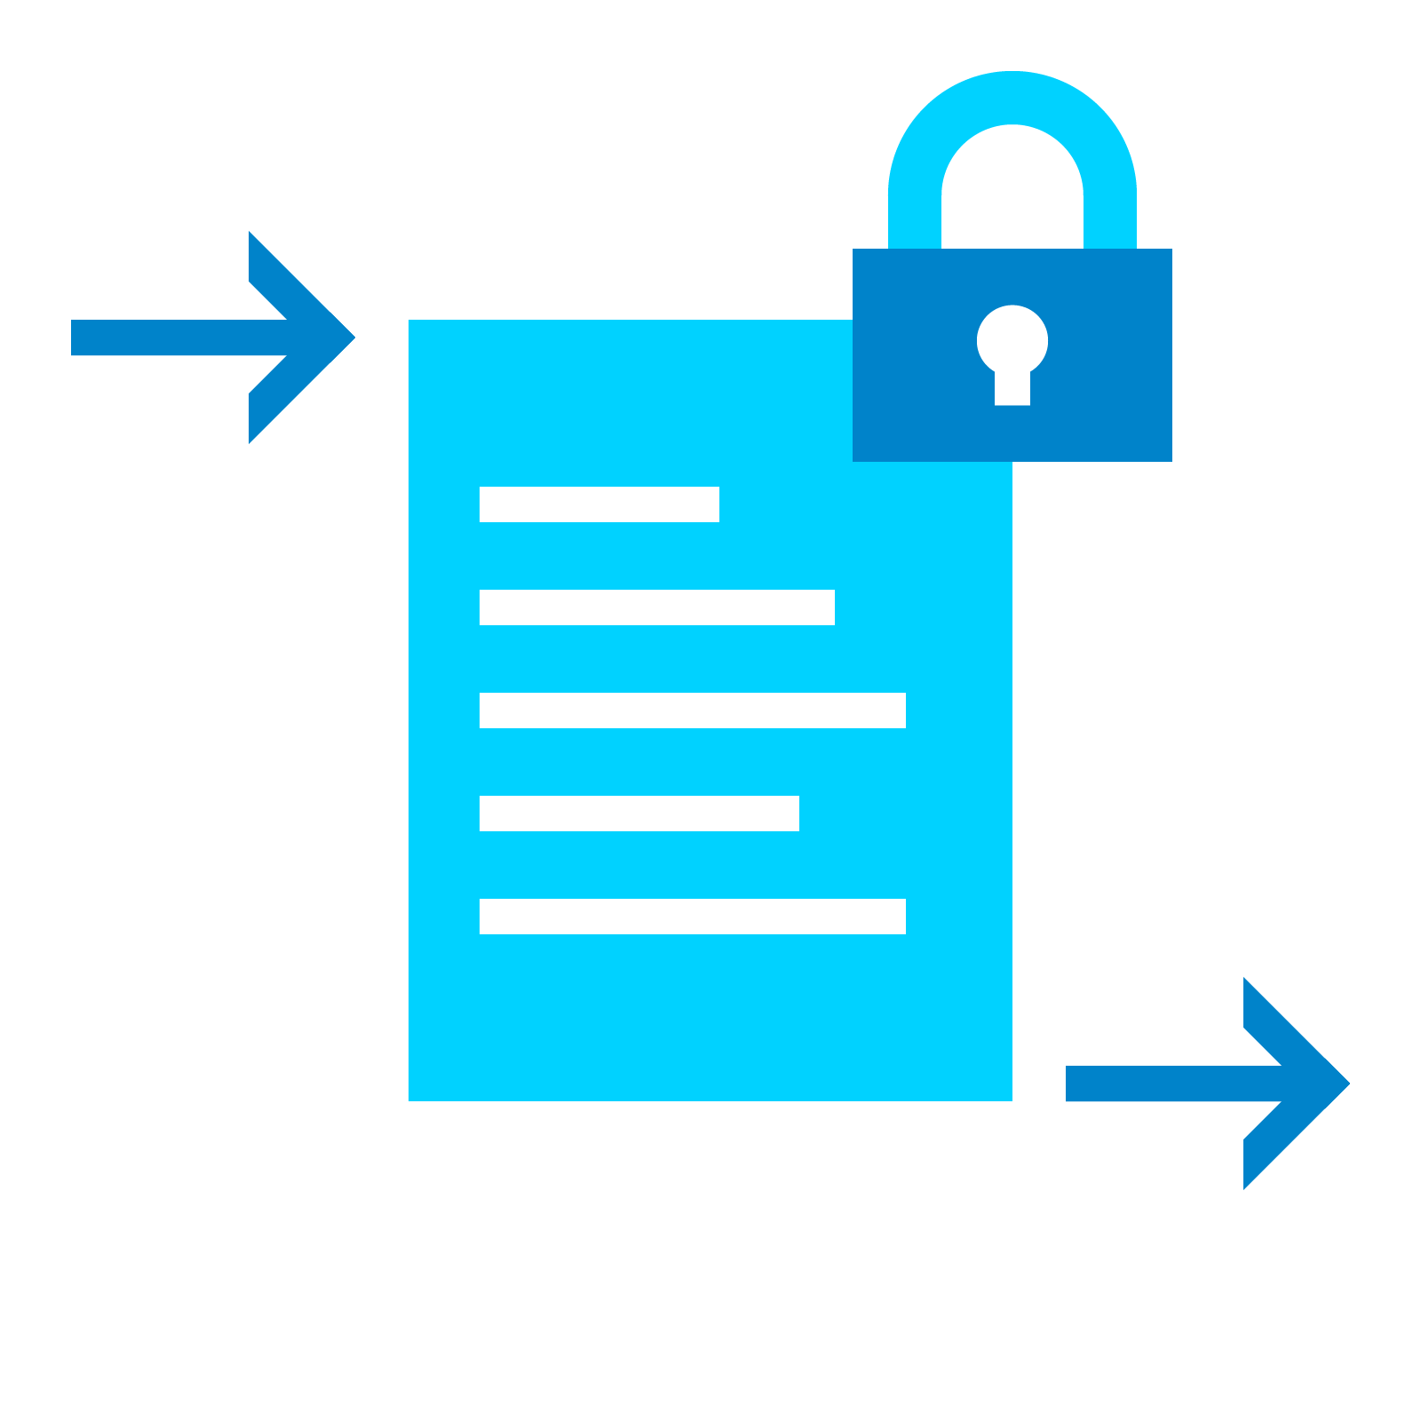
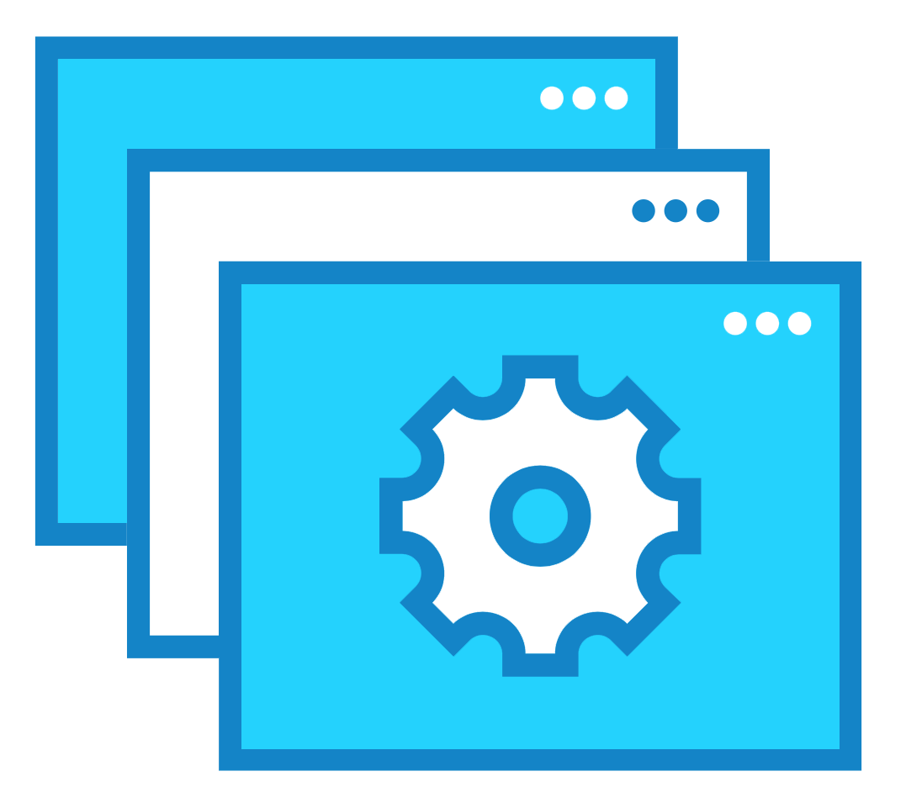
Complete Platform Must Support the 4 Pillars
B2B
Integration
Application
Integration
Big Data
Integration
Cloud
Integration
Integration Platform

Slide 5
B2B-Led Integration Approach
Connect internal systems,
partners and customers
Application
Integration
Technology Consolidation
Change Management
Rapid Onboarding
SLA Compliance
Consistency
B2B
Integration
Big Data
Integration
Cloud
Integration
Integration Platform

Slide 6
But How to Implement All 4 Pillars?
Connect internal systems,
partners and customers
B2B
Integration
Technology Consolidation
Change Management
Rapid Onboarding
SLA Compliance
Consistency
Integration Platform
Application
Integration
Big Data
Integration
Cloud
Integration

Slide 7
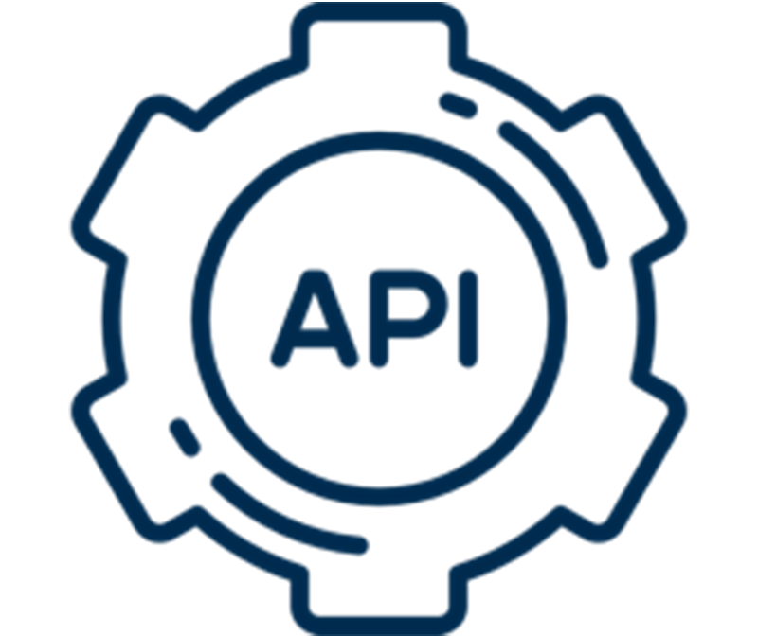
Common Approaches and Challenges
API
Build from Scratch
Outsourced Service
Legacy Tools
Piecemeal integrations lack consistency and risk compliance
Poor service levels and uncontrolled costs
Difficult to understand and hard to scale and extend
Siloed Architecture
Resources
Lack of data governance and visibility
Difficult to retain staff with specialized skillsets

Slide 8
Complete, Flexible & Ubiquitous Integration
Embedded
B2B
CLOUD
ERP
Big Data
CRM
Data
Lakes
Applications
Integration
EDI
Cloud
Services
ON PREMISE
TMS
Complete
Flexible
Ubiquitous Integration
Movement
Transformation
Orchestration
Governance / Security
Cloud / Ground / Hybrid
Control / Outcome-based
Consumption-based
Any Data
Any Partner
Anywhere
B2B Integration-as-a-Service

Slide 9
B2B-Led Cloud Integration: A Superior Approach
Single Platform
Handle any protocol, data format, API, trading partner location, and file size
Modernization
Evolve legacy systems while connecting new SaaS applications
Robust EDI
Drive business exchanges faster through innovative EDI capabilities
File Acceleration
Stream large data sets, to any location, faster without downtime
Embedded Integration
Power all business integrations, and extend B2B capabilities to trading partners
Analytics Enablement
Manage highly secure and accelerated data pipelines that feed data lakes
Notes:
WHAT IF …
... you could have complete breadth and depth of integration options – meaning any protocol, any data format, any API, any trading partner location, any file size -- all in the same platform?
... you had an easy way of modernizing your legacy systems while connecting to any SaaS applications?
... you had a platform with strong EDI capabilities that was still innovative and evolving for the digital age?
... you had a way of streaming large data sets across large distances with minimal delay and resource consumption?
... you could embed integration technologies seamlessly into your offerings?
... you could bring core integration discipline to building the pipelines that feed your data lakes (streaming, acceleration, B2B, …)?

Slide 10
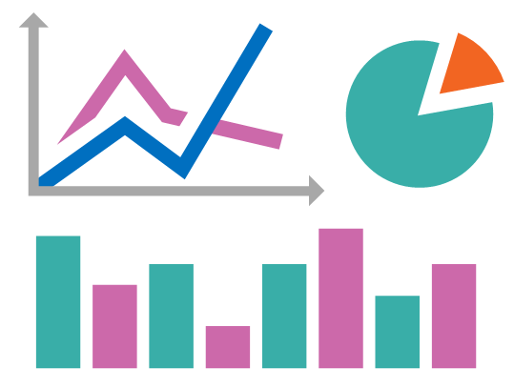
B2B-Led Cloud Integration: A Superior Approach
Data Transformation Legacy Migration B2B Gateway Ecosystem Enablement EDI Big Data
Embedded Integration Trading Partner Management Pipeline Acceleration Cloud Service Brokerage ERP
Self
Service
Integration Services
Customers
C-Level Executive
B2BiaaS
Partners
Director / LOB
Secure Protocols
Data Transformation
Data Orchestration
Data Governance
Suppliers
IT Admin
Notes:
A single cloud integration platform that allows you to construct, operate, and govern B2B, cloud, and application integration using both self-service and managed service experiences.

Slide 11
B2B-Led Cloud Integration: Benefits
Adding More Value
Achieve Faster Time to Value
Become easier to do business with and offer more services to customers
Onboard partners, enable business processes, and meet customer SLAs faster
Greater Business Agility
Fluid Business Processes
Easily collaborate and share information with both IT and business users
Extend integration processes beyond the edges of your B2B ecosystem
Notes:
YOU’D GAIN ….
The ability to say “YES” more often to your customers’ and partners’ needs, increasing how much business they do with you and creating new opportunities to expand and leverage your ecosystem.
Faster time to value because you will onboard partners faster, enable business processes quicker, and meet SLAs more consistently
A route to disrupt the status quo by offering new services based on insights driven by indisputable trends and solid analytics
Greater business agility because your stakeholders will be able to seamlessly collaborate faster and in more ways
Fluid business processes that create significant value at the edge of your digital B2B ecosystem

Slide 12
Realizing Business Outcomes
Ecosystem Enablement
Modernizing IT Systems
Improve Service Levels
End-to-End
Data Visibility
Your Business
With B2BiaaS
Connect, Transform, and Orchestrate Data
Connect Clouds
and Data Lakes
Integrate Your
Partners & Customers
Notes:
MARKET DYNAMICS
Companies are embracing integration technologies as a core competency that will enable them with exceptional flexibility in the front end of their business process ecosystem, while adding agility in their IT systems to proactively respond to changing market needs. Customers today are demanding low-friction automated means of integration into their environments.
Companies are increasingly modernizing their IT systems, as well as adopting newer SaaS applications to effectively differentiate and compete in the marketplace.
As companies modernize, they are forced to improve their level of service and capability while reducing cost. This forces them to delegate non-core capabilities of their IT and Application plant to purchased applications, and an explosion of options here has been fueled by the Cloud and automation techniques like APIs, DevOps, and EDI.

Slide 13
Extending Your Integration Strategy
Barry Sponsler
Sr. Solutions Architect
p: 570-628-9281
e: bsponsler@cleo.com

