Slide 1
Building a Cloud B2B/E-Commerce App on Your Terms
STEVE DAVIS
CHIEF TECHNOLOGY OFFICER
sdavis@four51.com
linkedin.com/in/stevedavis451
@stevefour51
BILL OSTERAAS
VP CHANNEL DEVELOPMENT
bosteraas@four51.com
linkedin.com/in/billosteraas
@bosteraas
Notes:
After operating as a customer for 3 years Steve Davis accepted a position with Four51 as a software developer. During his 10 years with Four51 he’s been the voice of the customer for the tech and development teams. His advocacy lead to the seeding of the API-first strategy and eventually the creation of the application development platform, or Dev Center. His role has expanded to Chief Technology Officer where he manages an ever growing technology team to realize the benefits of API-first strategies and continue to deliver innovation to the OrderCloud platform. @stevefour51
Bill has been with Four51 for 10 years in a variety of sales and business development roles. Bill is currently the Vice President of Channel Development and works to build a network of partners who development and implement world class solutions on the Four51 OrderCloud platform. @bosteraas

Slide 2
By the year 2018, more than 50% of commerce sites will integrate technologies from more than 15 vendors to deliver a digital customer experience.
Gartner Group, Magic Quadrant for Digital Commerce, 09 March 2016
“
”
Notes:
Contrast that to monolithic platforms where maintenance and customization is costly and can’t easily adapt to the changing needs of your business.
The agility you have with an API strategy is where enterprises have to head to remain competitive.
An API strategy is ultimately not about technology. An API strategy is an architectural approach that revolves around a particular way of thinking about interfaces. In other words, it is an approach that assumes that every software system may one day be addressed by multiple different, as-yet-unknown groups for unknown purposes. The discipline of creating, documenting, evolving and managing interfaces between systems is the core of what an API-centric approach is about. From this perspective, systems are loosely coupled, allowing a component service to have a wide range of future uses.
Another advantage is third-party APIs are often flat-out better. They work better and provide more flexibility than APIs that are built internally.
Companies often underestimate the amount of work that goes into building and maintaining the functionality that they can now get as a third-party API.

Slide 3
WHAT IS THE API ECONOMY?
It is well established that companies must enter the digital age to maintain and grow their business. If we all accept that “software is eating the world” and every business needs to think of themselves more like software firms then the choices of their technology becomes the leading challenge. The opportunity to own their own commerce application introduces the flexible and nimble capability to adapt to market changes and rapidly address the needs of their buyers. In this talk we’ll cover how the API economy delivers on these promises and why experienced software developers want to work with these tools.
The API Economy is the enabling of organizations and developers to innovate more rapidly by providing direct programmable access to loosely coupled systems and processes.
Marketing
Search
Misc.
Shipping
PIM
Tax
CUSTOMER
EXPERIENCE
CRM
Warehouse
ERP
CMS
Notes:
There is a rising wave of software innovation in the area of APIs that provide critical connective tissue and increasingly important functionality
Now, a new breed of third-party APIs are offering capabilities that free developers from lock-in to any particular platform and allow them to more efficiently bring their applications to market.
The monolithic infrastructure and applications that have powered businesses over the past few decades are giving way to distributed and modular alternatives. These rely on small, independent and reusable microservices that can be assembled relatively easily into more complex applications.
As a result, developers can focus on their own unique functionality and surround it with fully functional, distributed processes developed by other specialists, which they access through APIs.
Developers realize that much of the functionality they need to build into an app is redundant to what many other companies are toiling over. They’ve learned not to expend precious resources on reinventing the wheel but instead to rely on APIs from the larger platforms

Slide 4
“
No matter what the area, those who look to software-defined and cloud based solutions via API’s will outmaneuver those who look to monolithic platforms. They’re easier to procure, highly scalable and probably most importantly they let you adapt quickly to address business challenges.
”
Jeff Lawson, CEO, Twilio
Notes:
Contrast that to monolithic platforms where maintenance and customization is costly and can’t easily adapt to the changing needs of your business.
The agility you have with an API strategy is where enterprises have to head to remain competitive.
An API strategy is ultimately not about technology. An API strategy is an architectural approach that revolves around a particular way of thinking about interfaces. In other words, it is an approach that assumes that every software system may one day be addressed by multiple different, as-yet-unknown groups for unknown purposes. The discipline of creating, documenting, evolving and managing interfaces between systems is the core of what an API-centric approach is about. From this perspective, systems are loosely coupled, allowing a component service to have a wide range of future uses.
Another advantage is third-party APIs are often flat-out better. They work better and provide more flexibility than APIs that are built internally.
Companies often underestimate the amount of work that goes into building and maintaining the functionality that they can now get as a third-party API.

Slide 5
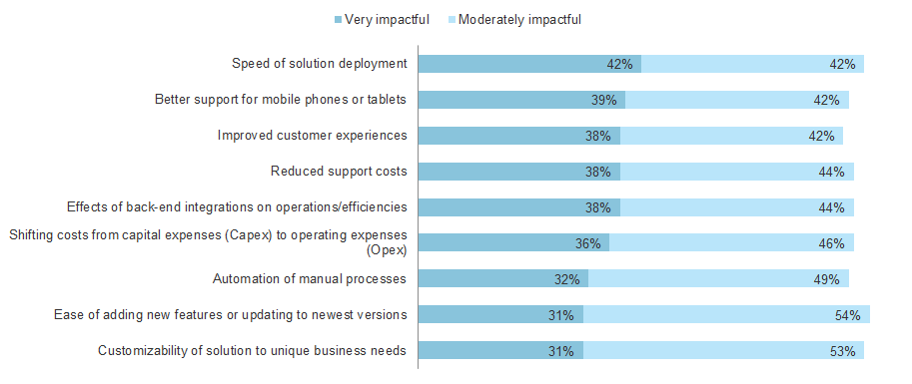
BENEFITS OF AN API STRATEGY
Which of the following reasons have you used to articulate the value of your preferred B2B eCommerce investments and to what extent have they made an impact?
BASE: 42 US software architecture and development professionals involved in B2B eCommerce / Order Management workflows
SOURCE: A commissioned study conducted by Forrester Consulting on behalf of Four51, March 2016
Notes:
Customization – be it of business processes, interfaces, or any other factor that makes a business unique – is essential (Q17). Developers seek PaaS B2B eCommerce solutions because they accommodate the needs of today’s businesses. PaaS users are motivated by these solutions’ abilities to customize in a number of ways, accommodate the new technologies customers want to use, and move at modern speed at a lower price point (Q6). What makes PaaS-based B2B eCommerce succeed depends on company segments. Vendors prioritize RESTful APIs, customers need ongoing support services, and partners value documentation (Q18).
APIs cut down on distractions. They allow you to outsource parts of your operations and infrastructure to other companies that are domain experts. APIs help you acquire knowledge. Allowing parts of your application infrastructure to be handled by experts puts you in the position to learn from said experts. APIs help you tap a broader application ecosystem for value. The more that you allow experts to help you with non-core parts of your application infrastructure, the more nodes of a network of experts you are connected with.
Our perspective: APIs help you create & test new offerings. By opening your own API, you’re opening your business to be leveraged by an ecosystem of customers & partners that may help create new opportunities for your business.

Slide 6
“
Despite purchasing’s role in IT providing cheap or cost-effective capacity, business lines are increasingly impatient with a traditional, functional-based IT service model because it’s too slow and unresponsive or too cumbersome to engage…
”
Peter Bendor-Samuel
Founder and CEO, CIO.com
Notes:
Business value is the objective in the Digital Age, and speed is the new currency. Cost reduction today is achieved by migrating to the new elastic, consumption-based pricing models where the business pays for only what it uses. In addition, IT is beginning to operate in integrated service models, which collapse the old barriers between middleware, infrastructure, application maintenance, and DevOps. Moreover, speed kills cost. It turns out that the biggest driver of costs on a digital project is the amount of time the project takes. So IT completes it quickly – even by using expensive labor and expensive tech components, it costs a fraction of the cost to do it with lower-cost IT components and low-cost labor.

Slide 7
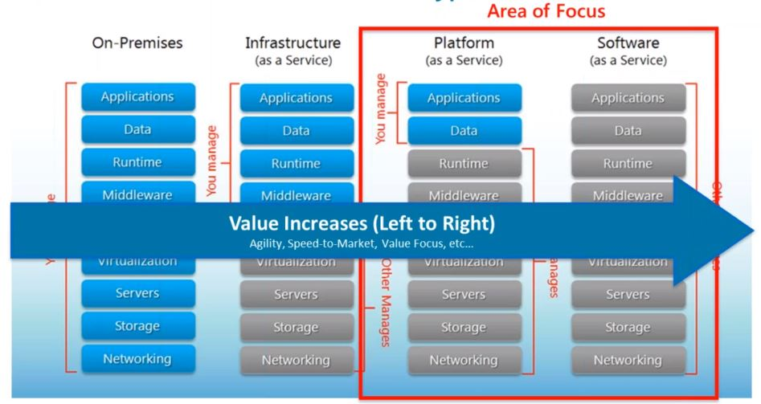
NOT THE FUTURE… THE PRESENT
Today’s Enterprise is seeking out new digital innovation strategies and they are recognizing the shift in technology.
Notes:
Enterprises are looking to take their technology out of house and into the “cloud”. That technology needs to be available and delivered to them on their terms.
This was from Land O Lakes.. They don’t want to invest in on-premise if they can avoid it. Getting to the SaaS model customized for their market is only enabled by API platforms.
SaaS Environments Don’t Heal The Ails of B2B eCommerce Developers’ Pain Points…
Limited UI options
Inadequate integrations
Limited scaling (due to upgrades)
Poor adaptability to business processes/needs
Limited developing for individual channels (mobile vs web)
…And Neither Do On Premise Environments
Challenge dealing with internal procurement
Cost of maintenance, acquisition, implementation
Poor adaptability to business processes/needs
Time to acquire, install, deploy and maintenance
Configuration of support environments (test, development, production)

Slide 8
“
Developers and technical initiatives alike drive B2B eCommerce projects. They have a prominent seat at the table when evaluating and selecting solutions.
”
Jeffrey Hammond, Vice President & Principal Analyst, Forrester Research
Notes:
Developers are active participants in the evaluation and selection of B2B eCommerce solutions. In fact, participation in such activities has recently increased for 58% of the developers we surveyed,a third of whom said their roles had become much more involved.The share of developers involved in such decision-making activities is particularly sharp at customer organizations (i.e., end user organizations) and partner organizations (e.g., systems integrators, digital agencies, and consultants)

Slide 9
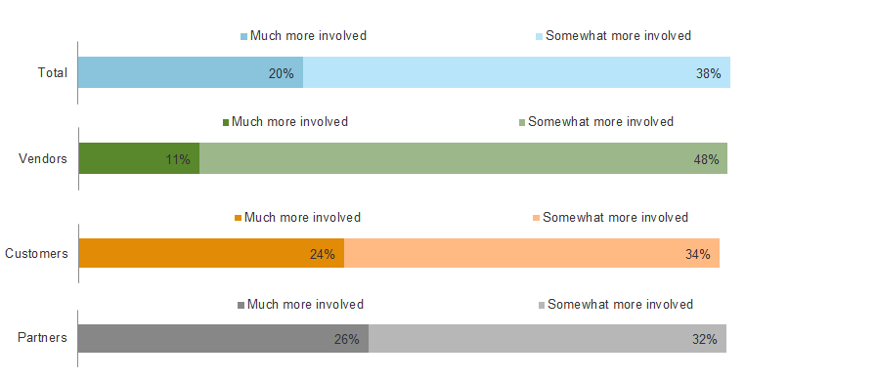
DEVELOPERS ARE INCREASINGLY INVOLVED IN EVALUATION AND SELECTION
To what extent has the role of developers in the evaluation and selection of B2B eCommerce solutions at your organization changed recently?
BASE: 42 US software architecture and development professionals involved in B2B eCommerce / Order Management workflows
SOURCE: A commissioned study conducted by Forrester Consulting on behalf of Four51, March 2016
Notes:
Businesses demand that their eCommerce systems be cost-efficient, feature-rich, and differentiated from the competition. Furthermore, such systems must be quick to deploy and capable of supporting unique business processes.
The lack of necessary integrations with other technologies and capabilities ranks as the No. 1 inhibitor of successful B2B eCommerce workflows among our respondents.
Tied for No. 2area lack of customization to business needs and difficulty integrating with other back-end systems.
Difficulty customizing the user experience and extending support to mobile devices also made the list of top inhibitors

Slide 10
“
For many developers, APIs have become the foundational architecture that allows them to manifest their vision. Consider the Pareto Principle, which states that 80 percent of the effects come from 20 percent of the causes; apps and cloud services already do 80 percent of what your application needs so leverage that ecosystem to focus in on the 20 percent of “magic” that you can call your own.
Adam DuVander, Developer Communications Director, SendGrid
”
Notes:
Contrast that to monolithic platforms where maintenance and customization is costly and can’t easily adapt to the changing needs of your business.
The agility you have with an API strategy is where enterprises have to head to remain competitive.
An API strategy is ultimately not about technology. An API strategy is an architectural approach that revolves around a particular way of thinking about interfaces. In other words, it is an approach that assumes that every software system may one day be addressed by multiple different, as-yet-unknown groups for unknown purposes. The discipline of creating, documenting, evolving and managing interfaces between systems is the core of what an API-centric approach is about. From this perspective, systems are loosely coupled, allowing a component service to have a wide range of future uses.

Slide 11
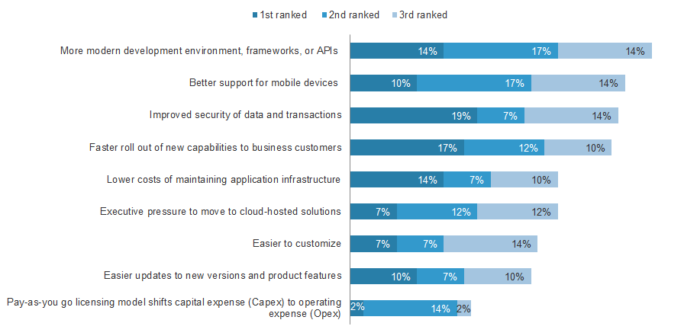
DEVELOPERS’ MOTIVATION
You said that you anticipate to increasingly develop B2B eCommerce projects in a commerce Platform-as-a-Service (PaaS) environment. Which of the following factors support your reasoning the most?
BASE: 42 US software architecture and development professionals involved in B2B eCommerce / Order Management workflows
SOURCE: A commissioned study conducted by Forrester Consulting on behalf of Four51, March 2016
Notes:
An API-first approach supports custom development of user interfaces and eases integration with commercial applications, the two most important elements of B2B eCommerce customization valued by our respondents (88%and 85%, respectively).
Other customization wants include integration with RDBMes, plug-in architectures, access to open source code, and accommodation of unique business processes. In fact, nearly three-quarters of respondents said any of the customization components we asked about are important or critically important in the solutions they seek. Interestingly, developers at end user customer organizations generally value customization more than the partners and vendors that serve them. Although the strong majority of developers at vendor organizations said customizations are important, they are comparative laggards when it comes to the magnitude of that importance

Slide 12
“
That’s why an API strategy depends on proper definition, governance, quality assurance and a plan for making your APIs discoverable and consumable by developers. It’s also important that you learn how to manage and curate your community, providing developers the trust, assurance and resources they need to successfully leverage your APIs.
Manfred Bortenschlager, API Market Development Director, 3Scale
”
Notes:
Contrast that to monolithic platforms where maintenance and customization is costly and can’t easily adapt to the changing needs of your business.
The agility you have with an API strategy is where enterprises have to head to remain competitive.
An API strategy is ultimately not about technology. An API strategy is an architectural approach that revolves around a particular way of thinking about interfaces. In other words, it is an approach that assumes that every software system may one day be addressed by multiple different, as-yet-unknown groups for unknown purposes. The discipline of creating, documenting, evolving and managing interfaces between systems is the core of what an API-centric approach is about. From this perspective, systems are loosely coupled, allowing a component service to have a wide range of future uses.

Slide 13
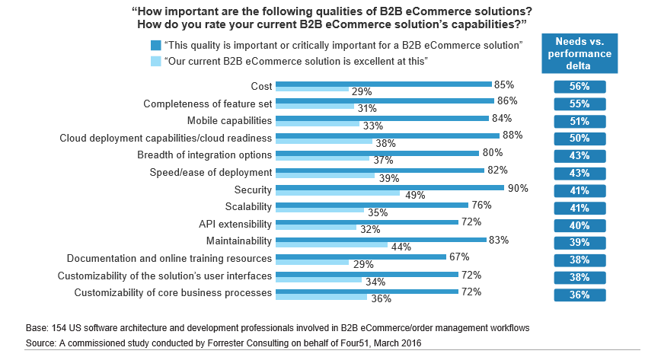
WHAT CONSTITUTES A QUALITY API SERVICE?
Provides a valuable service
Make it simple and flexible
It should be managed and measured
Provide great developer support
Documentation and code samples
Provide technology strategies
Notes:
Writable IDs
Extensibility of the resources (XP)
Webhooks
Elevated claims
Partial resource modification
SDKs or seeds
Training
Documentation / Swagger OpenAPI / RAML
Outstanding support
Security / PCI / SOC 2 / HIPAA / OAuth 2.0
Code samples
Sandbox
Vetted consulting and technology partners
Componentized architecture

Slide 14
“
Developers are continually looking to break down obstacles of production. They want to discover platforms and immediately become productive.
”
Steve Davis, Chief Technology Officer, Four51 Inc. and OrderCloud.io
Notes:
Developers are active participants in the evaluation and selection of B2B eCommerce solutions. In fact, participation in such activities has recently increased for 58% of the developers we surveyed,a third of whom said their roles had become much more involved.The share of developers involved in such decision-making activities is particularly sharp at customer organizations (i.e., end user organizations) and partner organizations (e.g., systems integrators, digital agencies, and consultants)

Slide 15
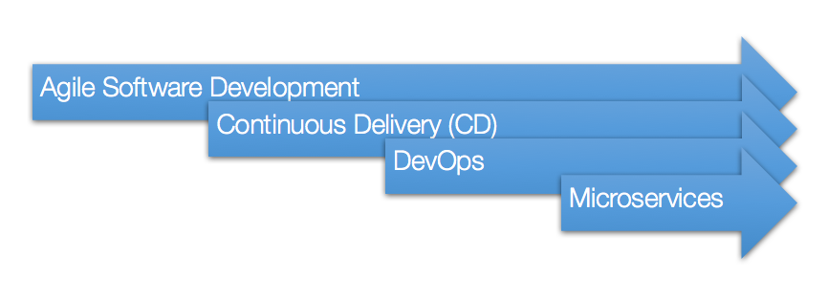
ONCE THE RIGHT SERVER SIDE TECHNOLOGY IS CHOSEN HOW DO YOU DELIVER?
Software development has undergone fundamental changes to delivery. All of which enables rapid development of the RIGHT solution for the customer.
Notes:
Not long after Agile took hold, the concept of Continuous Delivery (CD) was born to address bottlenecks in software deployment. CD can be considered the 2nd phase of Agile, and was a natural extension of Continuous Integration (CI), a quality control mechanism used in Agile development. Agile’s primary scope was to accelerate and improve the development of software, and Continuous Delivery saw the scope extended to include the deployment of code into production — previously an operations task.
It’s no surprise then that the 3rd phase of the Agile journey is known as “DevOps”. Continuous Delivery without the involvement of Ops had limited success and led to the emergence of the term “Fragile Agile” – where a lack of operational rigour often leads to quality problems.
To combat this, Agile organisations are now working to unify development and operations capabilities within the same delivery team — leading to highly effective CD practices, improved quality and velocity. Phase 3 of the Agile journey can be described as organisational or cultural change.
Increased collaboration between Dev and Ops also means increased empathy. Developers are now building software that considers an operational perspective from the outset, and operations people are taking an engineering approach to tackle Ops-related problems – problems that used to be dealt with procedurally. This, and greater use of infrastructure automation results in greater stability and resilience for your applications.
And now we’re entering the 4th phase – Microservices – which seeks to address application architecture constraints.
Most software today is delivered as part of a single “application stack”. In the fast moving world of web native applications, this ageing architecture is far from ideal. As your business scales and increases in complexity, it becomes an impediment to new feature delivery, and the lack of scalability causes maintenance and stability problems.

Slide 16
“
So, the minimum viable product is that product which has just those features (and no more) that allows you to ship a product that resonates with early adopters; some of whom will pay you money or give you feedback.
Eric Ries, Author of The Lean Startup
”

Slide 17
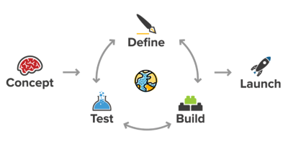
MINIMAL VIABLE PRODUCT AND ITERATE
The directive of an MVP is to deliver on customer value immediately. Using customer feedback and usage metrics you recognize additional value that should be added and deliver that in an iterative fashion.
Notes:
Minimal Viable product and iterate.
This is the antithesis of the monolithic solution. It’s widely understood that your requirements will change a number of times before the project is deployed to production.
These changes result in delays and lack of visible progress. Reduce the scope, delivery and refine.

Slide 18
“
Putting object design before procedural action design, and thinking about a system through the lens of the real-world objects in a user’s mental model. We determine the actions after first defining the objects, as opposed to the traditional actions-first process that jumps straight into flows, interactions, and features.
Sophia Voychehovski, Founder and lead of ReWired UX Studio
”

Slide 19
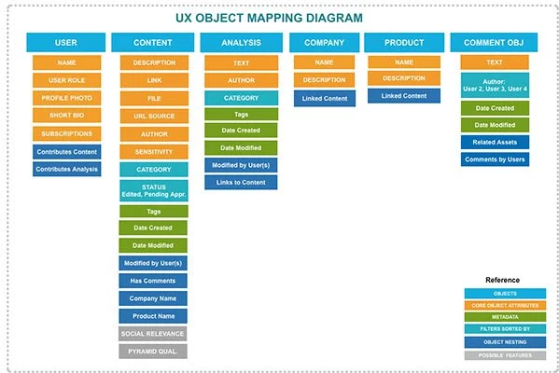
OBJECT ORIENTED USER EXPERIENCE (OOUX)
It follows the same mindset with developers, which will save developer’s time and benefit for component reuse.
It matches user mental model, and can improve their experience.
It is a great starting point, easy to maintain and grow your product with more objects. New object can be added without affecting the rest of the system and object can be improved based on user feedback.
Notes:
It put object design before procedural action design, and think about the entire system in line with real-world objects in users’ mental model, not digital-world actions (search, filter, compare and check out). Action design comes after defining the objects, as opposed to the traditional action-first process that jumps straight into flows, interactions and features.
Described the problem in one paragraph.
Stripped out all the objects/ nouns and all behaviors / interactions between those objects.
Connect the objects and their behaviors in the object mapping diagram.

Slide 20
“
Agile Development is adaptive rather than predictive.
Agile Development is people-oriented rather than process-oriented.
”
Martin Fowler, Chief Scientist at ThoughtWorks and Principal Author of the Agile Manifesto

Slide 21
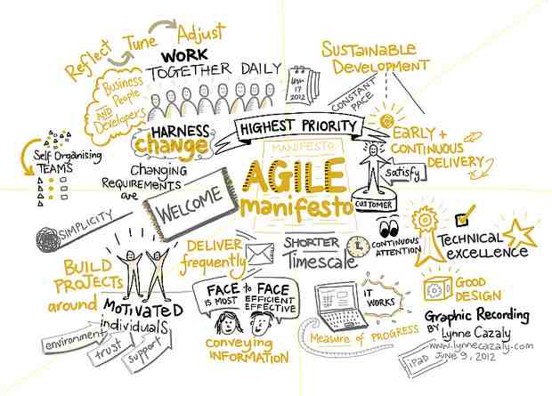
AGILE SOFTWARE DEVELOPMENT
Individuals and interactions over processes and tools
Working software over comprehensive documentation
Customer collaboration over contract negotiation
Responding to change over following a plan
http://agilemanifesto.org/principles.html
Notes:
All about the ability to react to change
Let the dev team take over and manage timelines and expectations
User stories
Backlog grooming
Sprint planning
UAT
Get frequent sign off from your customer
Take feedback and iterate

Slide 22
“
DevOps is a way of working or an agile methodology whereby developers and system operators work in harmony with little or no organisational barriers between them towards a common goal.
”
Paul Swartout, Author of DevOps: Continuously Deliver Better Software

Slide 23
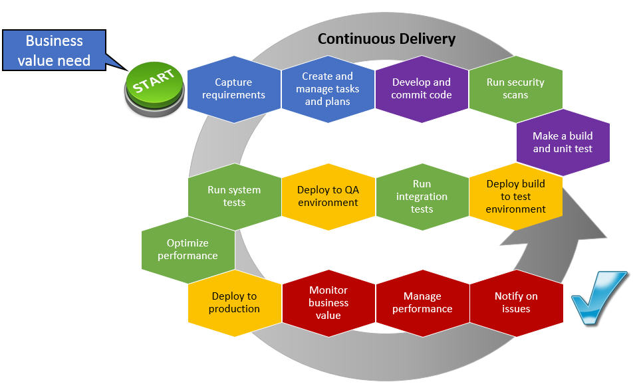
DEVOPS and CONTINUOUS DELIVERY
Individuals and interactions over processes and tools
Working software over comprehensive documentation
Customer collaboration over contract negotiation
Responding to change over following a plan
Notes:
Continuous development and deployment
Automated builds and tests
Feature based releases / Github flow
Minimize effect of every release
http://agilemanifesto.org/principles.html

Slide 24
Building a Cloud B2B/E-Commerce App on Your Terms
STEVE DAVIS
CHIEF TECHNOLOGY OFFICER
sdavis@four51.com
linkedin.com/in/stevedavis451
@stevefour51
BILL OSTERAAS
VP CHANNEL DEVELOPMENT
bosteraas@four51.com
linkedin.com/in/billosteraas
@bosteraas
Notes:
After operating as a customer for 3 years Steve Davis accepted a position with Four51 as a software developer. During his 10 years with Four51 he’s been the voice of the customer for the tech and development teams. His advocacy lead to the seeding of the API-first strategy and eventually the creation of the application development platform, or Dev Center. His role has expanded to Chief Technology Officer where he manages an ever growing technology team to realize the benefits of API-first strategies and continue to deliver innovation to the OrderCloud platform. @stevefour51
Bill has been with Four51 for 10 years in a variety of sales and business development roles. Bill is currently the Vice President of Channel Development and works to build a network of partners who development and implement world class solutions on the Four51 OrderCloud platform. @bosteraas

